Slide 1
Bias-preserving gates with stabilized cat qubits
汇报人：余轲辉
指导老师：李宏荣、王信
2021 年 9 月

Slide 2

Question
What do we need on the road to fully universal quantum computing ?

Slide 3
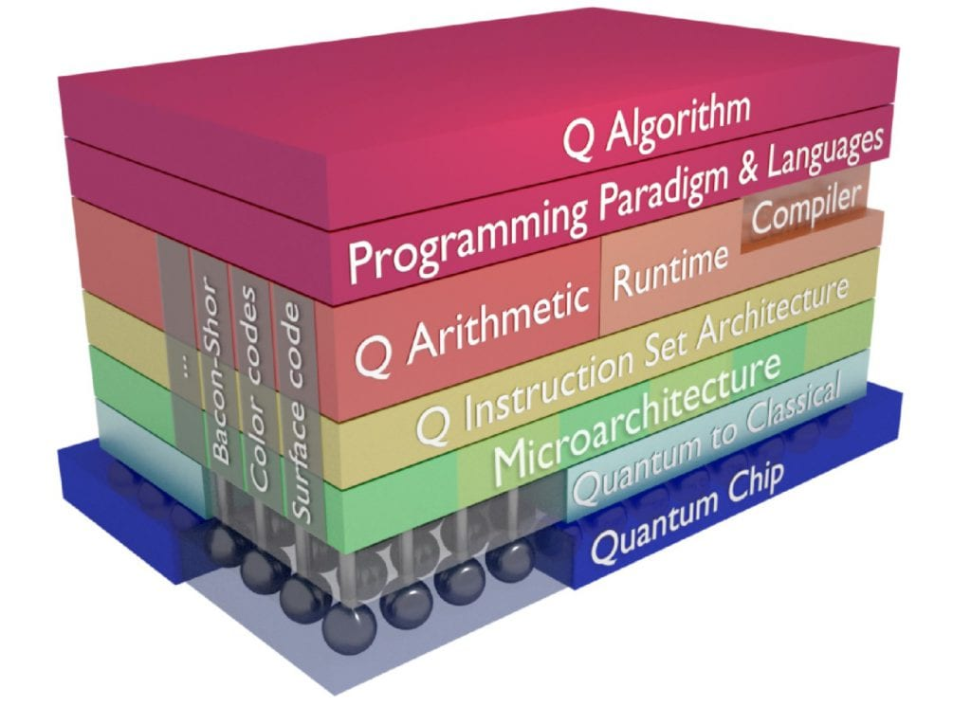
Background
7-layer configuration
Q Algorithm
Programming Languages
Q Arthmetic
Q Instruction Set
Microarchitecture
Quantum to Classical
Quantum Chip
Fig. 1. Quantum computing stack
The basis of this architecture is quantum chip (superconduncting quantum circuits, quantum dots)
The middle part between the chip and the algorithm translates the quantum algorithm into control pulses acting on the physical chip.
Quantum bits are extremely fragile. The way forward is to correct the errors faster than they appear, a notion called fault-tolerance.
The approach to achieve fault-tolerant quantum computing is based on Quantum Error Correction.

Slide 4
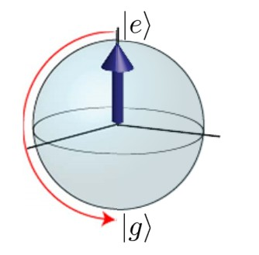
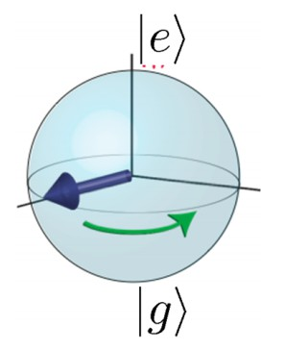
Quantum Error Correction
The cause of errors
Interaction of quantum system with environment
Energy loss &
Decoherence
Errors
Bit-flip
Energy Loss
(Decay)
Loss of quantum information
Decoherence
Dephasing

Slide 5
Quantum Error Correction
Review: Classical error correction
Redundancy encoding: Storing information multiple times
Error correction: If these copies disagree, take the majority of the correct values
Bit flip code:
Analogous to classical repetition code, this method uses three entangled physical qubits to encode one logical qubit.
Quantum Errors
Bit flip
Dephasing
Sign flip code:
Constructing three-body entangled state in the Hardmard basis.
QEC strategies
Shor code:
Shor code corrects arbitrary single-qubit errors.
Coding in groups of three
Bosonic codes:
Storing error-correctable quantum information in bosonic modes
Cat/Gottesman-Kitaev-Preskill (GKP)/Binomial

Slide 6
Bias-noise
Current Situations
The overhead to realize QEC is too large to afford at this era.
In the widely studied depolarizing noise model, assuming that the stochastic error occurs in X, Y and Z channel is equal.
In many physical systems, noise is asymmetrical (fluxonium、quantum-dot spin qubits、nuclear spins in diamond).
In the asymmetric noise system, it is better to design QEC strategies aimed to suppress the dominant error with lower overhead.

Slide 7
Bias-noise
Current Problems
There has a surface code tailored to biased Z channel noise. However, this approach is very limited beacuse the qubit could not be protected if the gate, such as X and Y, is not commuted with biased noise channel.
QEC with noise-biased channel is impossible in a native two-level system.

Slide 8
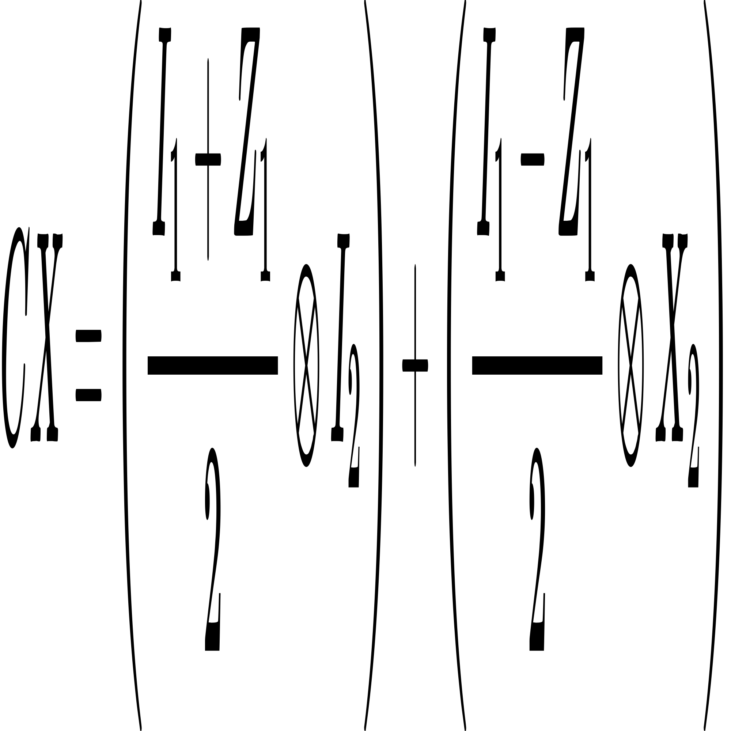
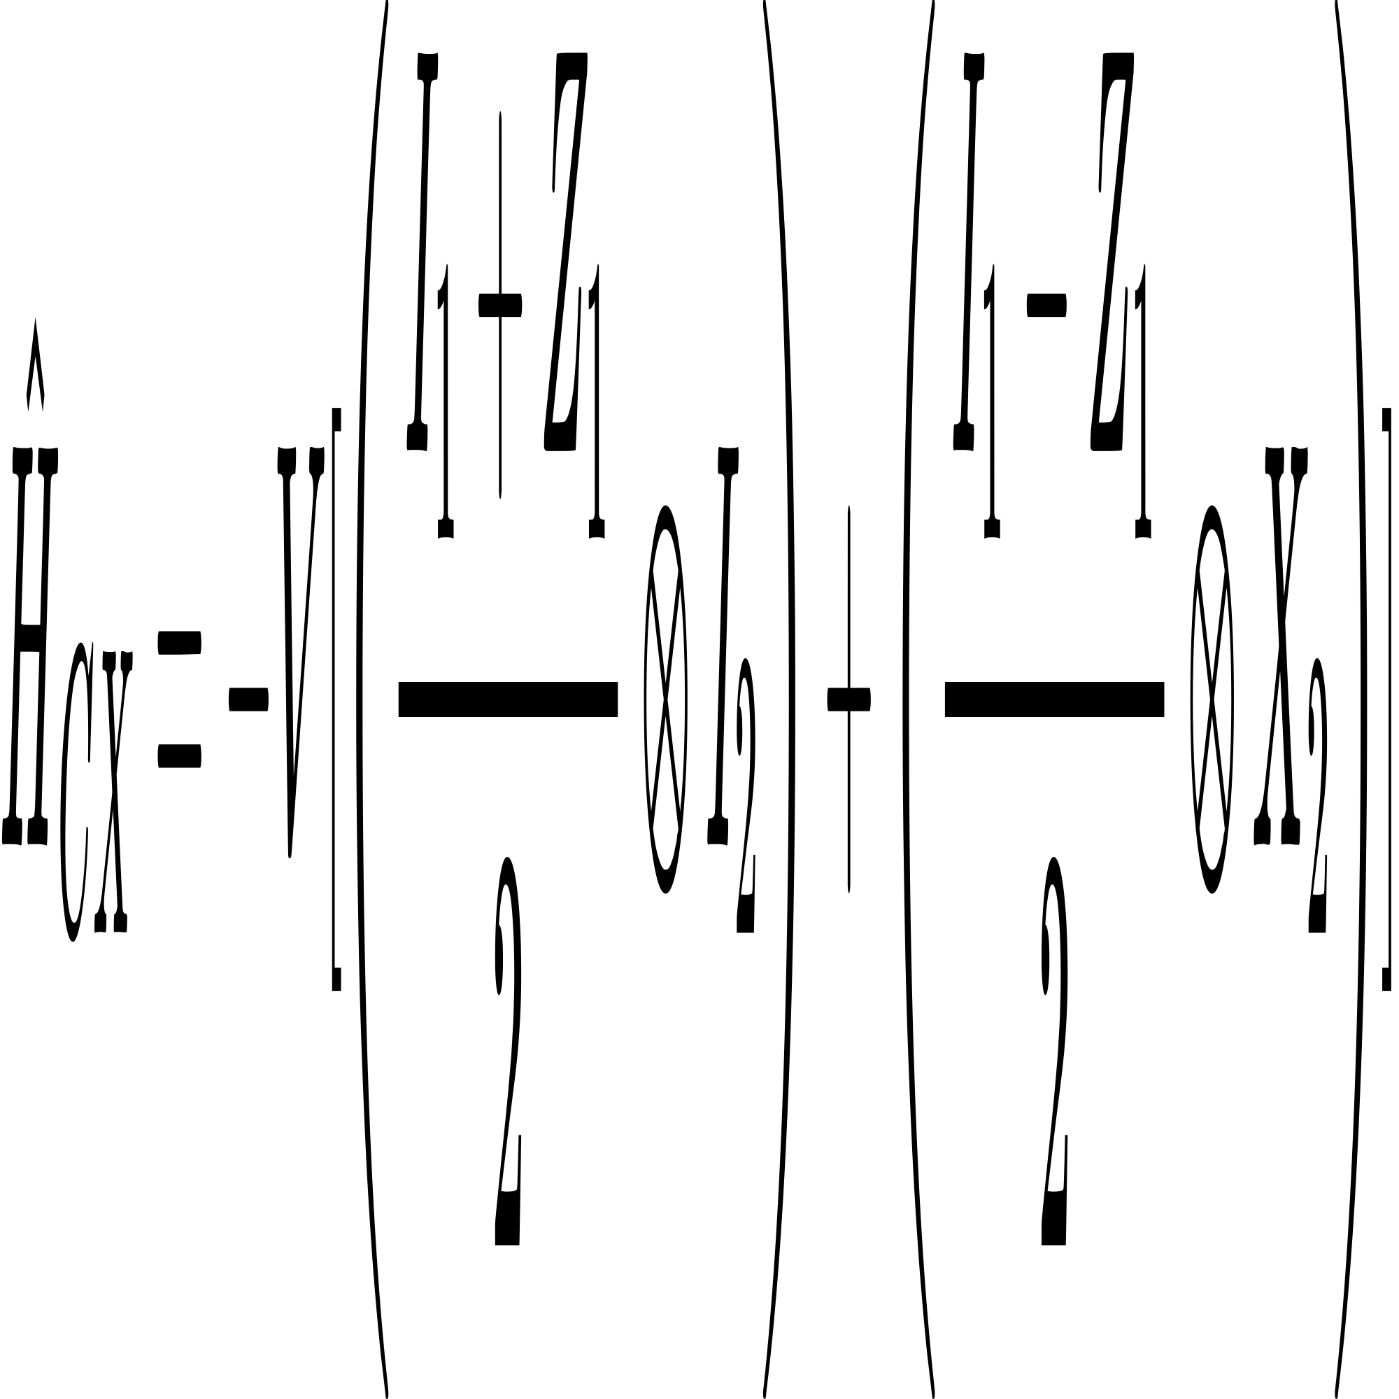
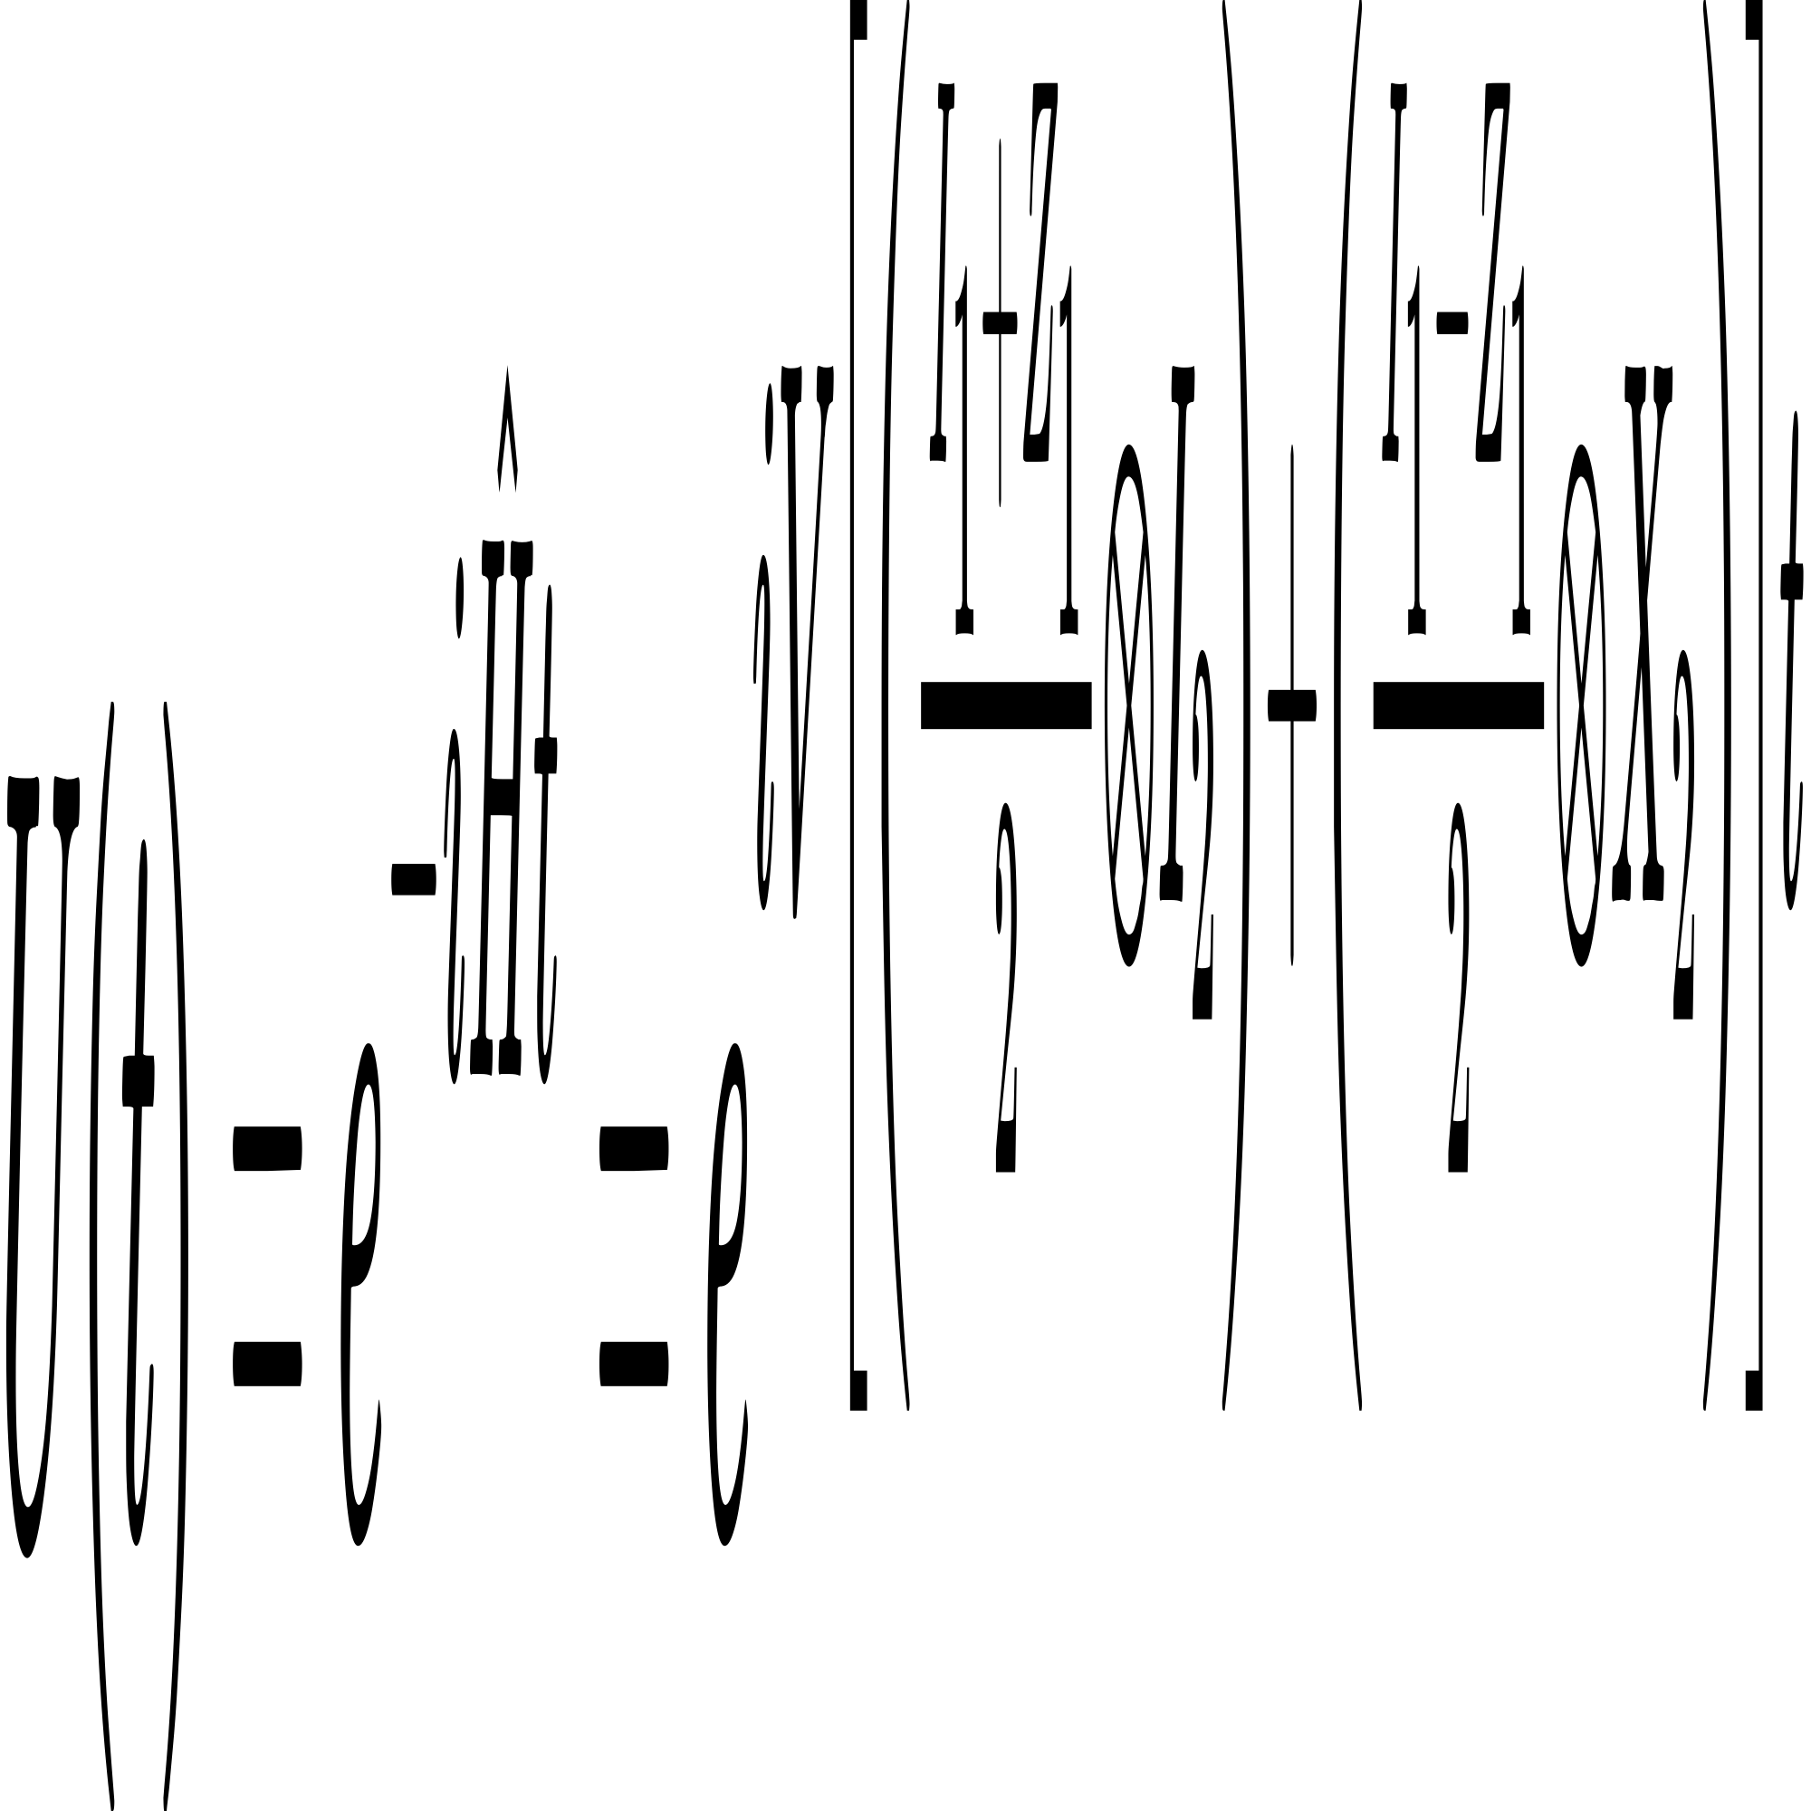
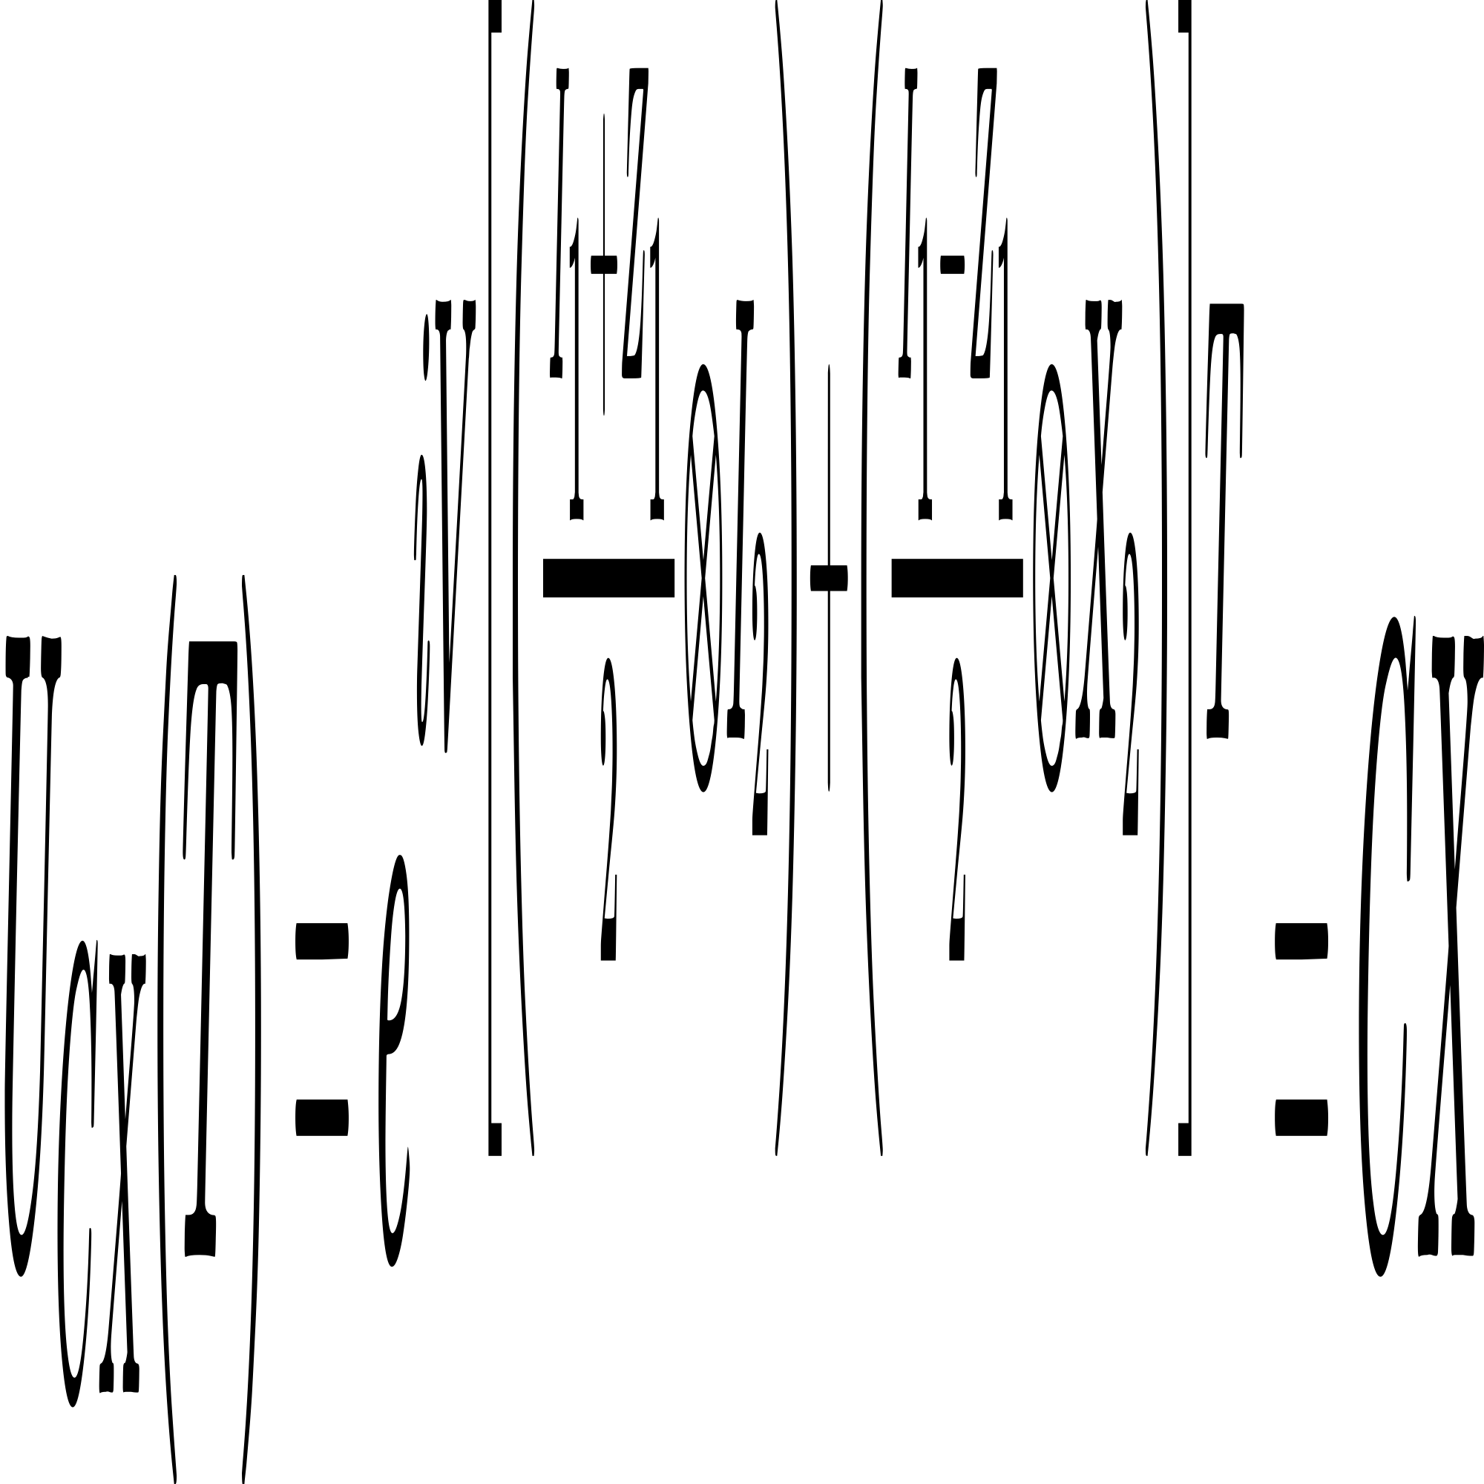
Bias-noise
Proof 1: 2-level system cannot build universal biased-preserving gate sets
Assuming that the biased noise is Z channel error
We want to implement a CX gate
Physical Realization
CX gate:
Hamlitonian:
Time evolution:
Unitary CX:

Slide 9
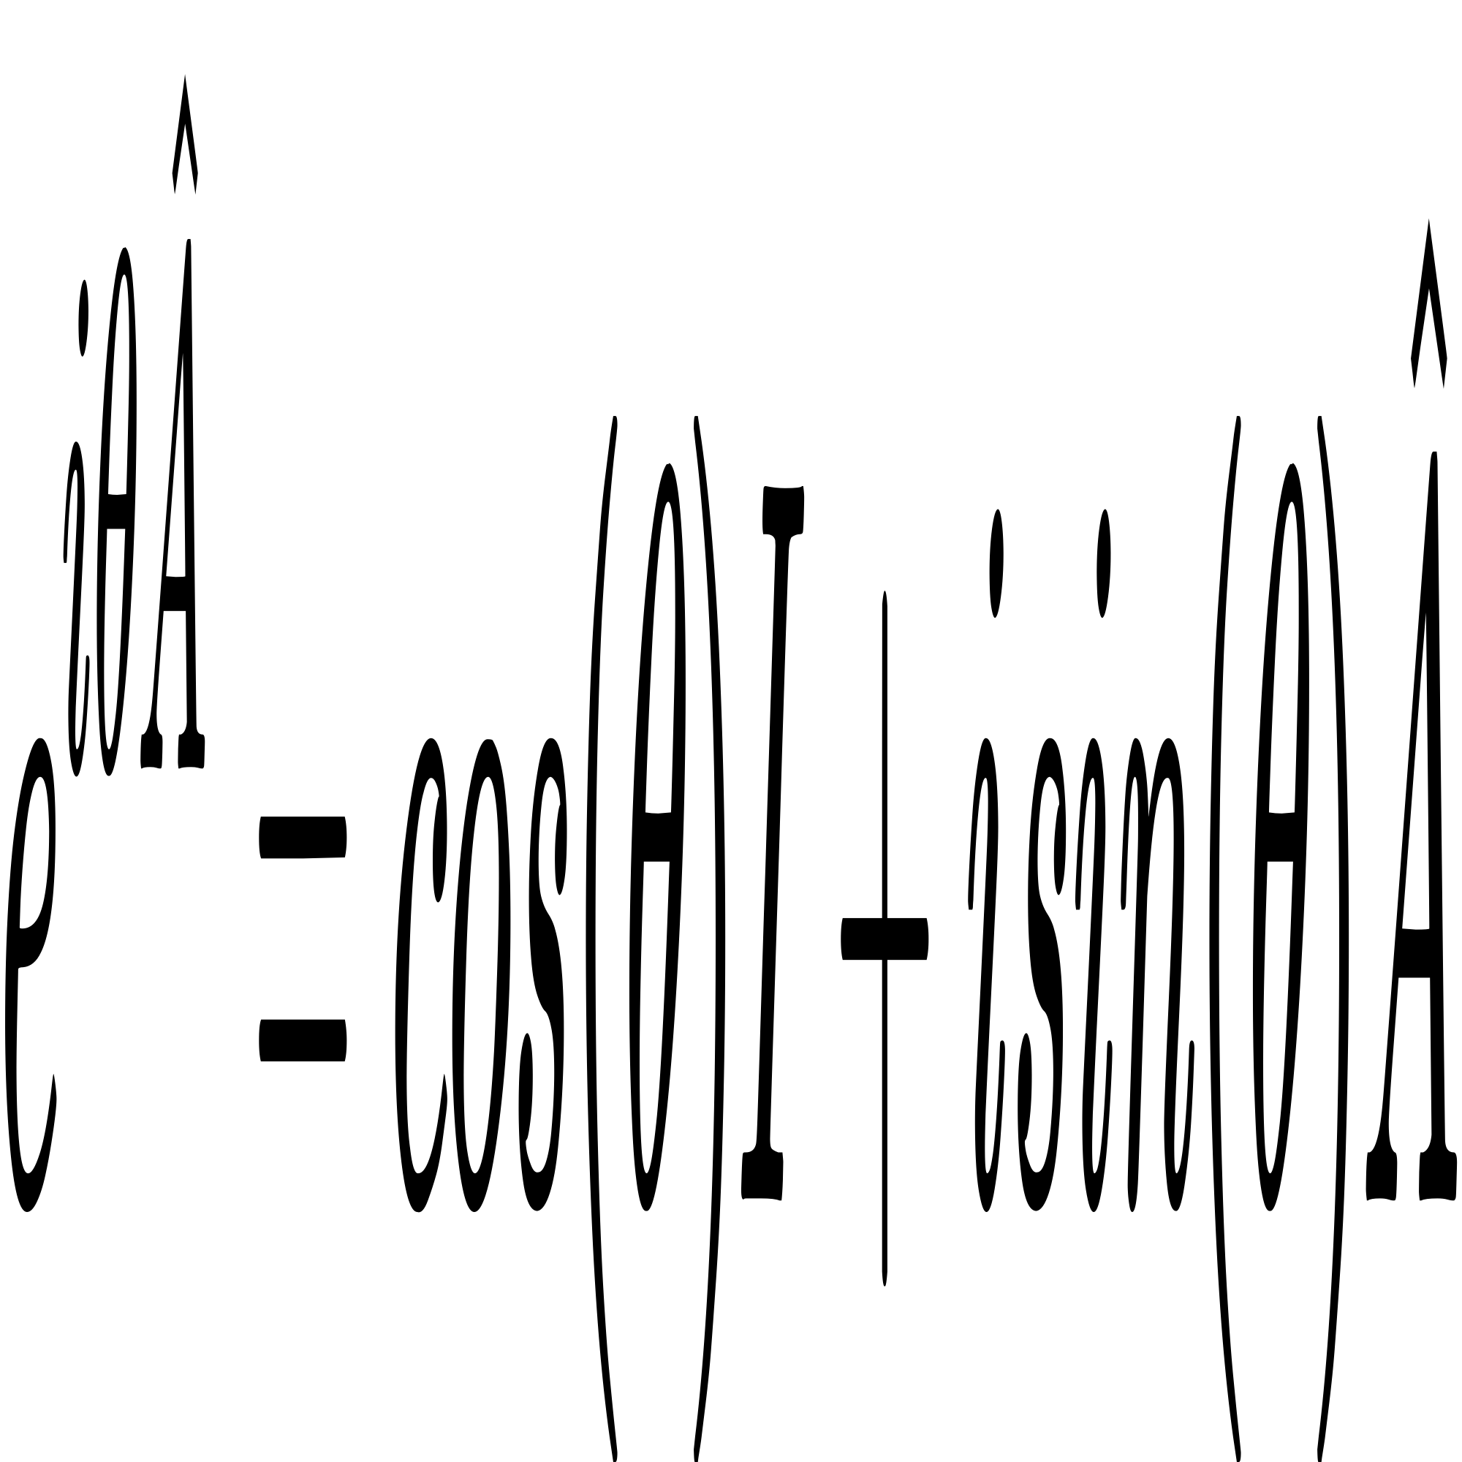
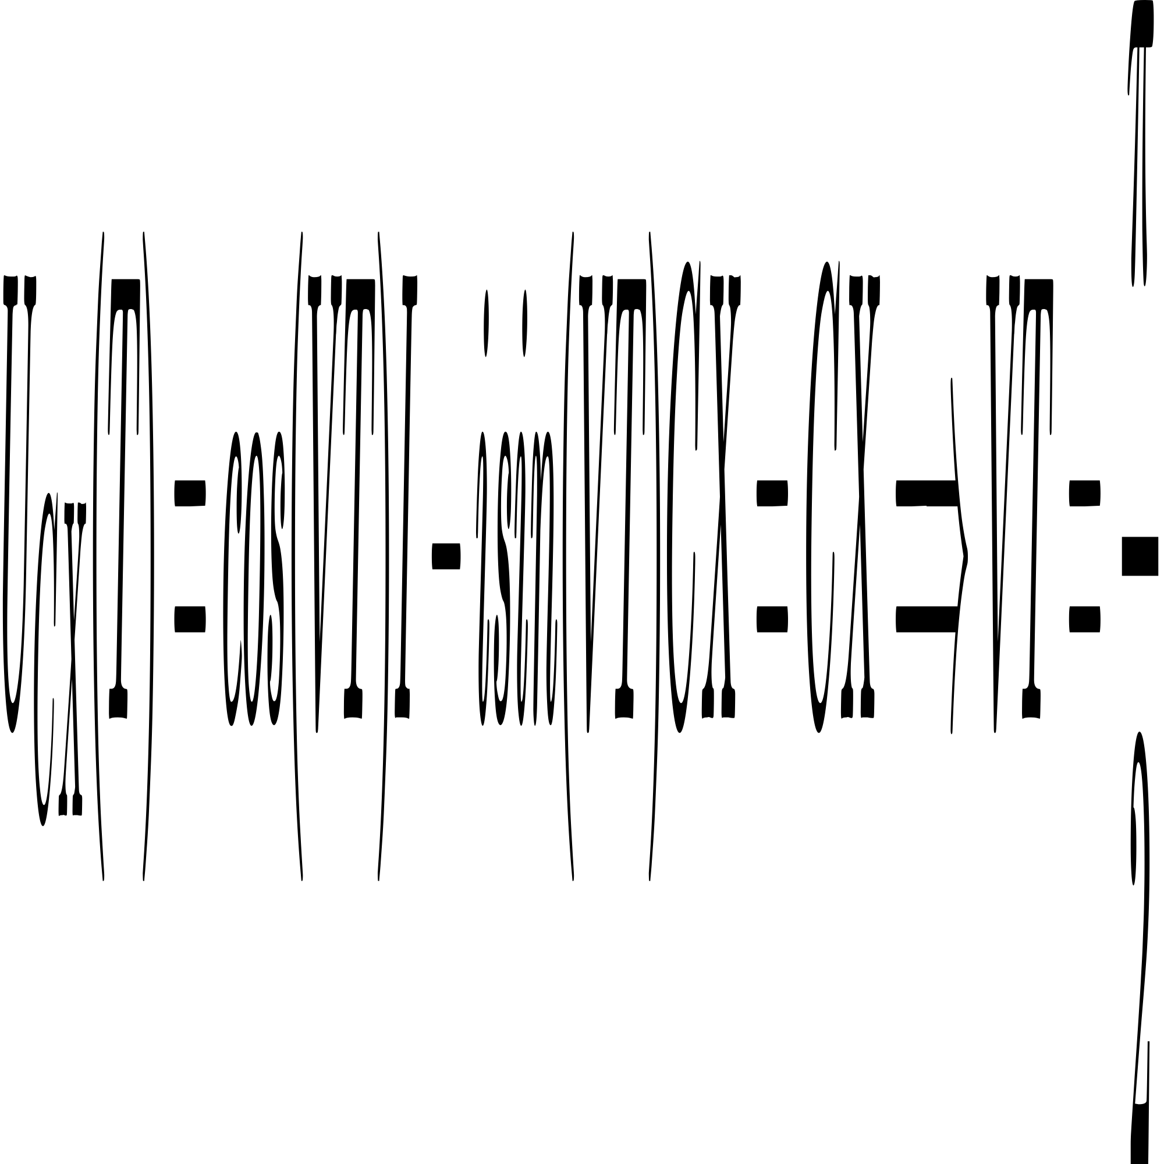
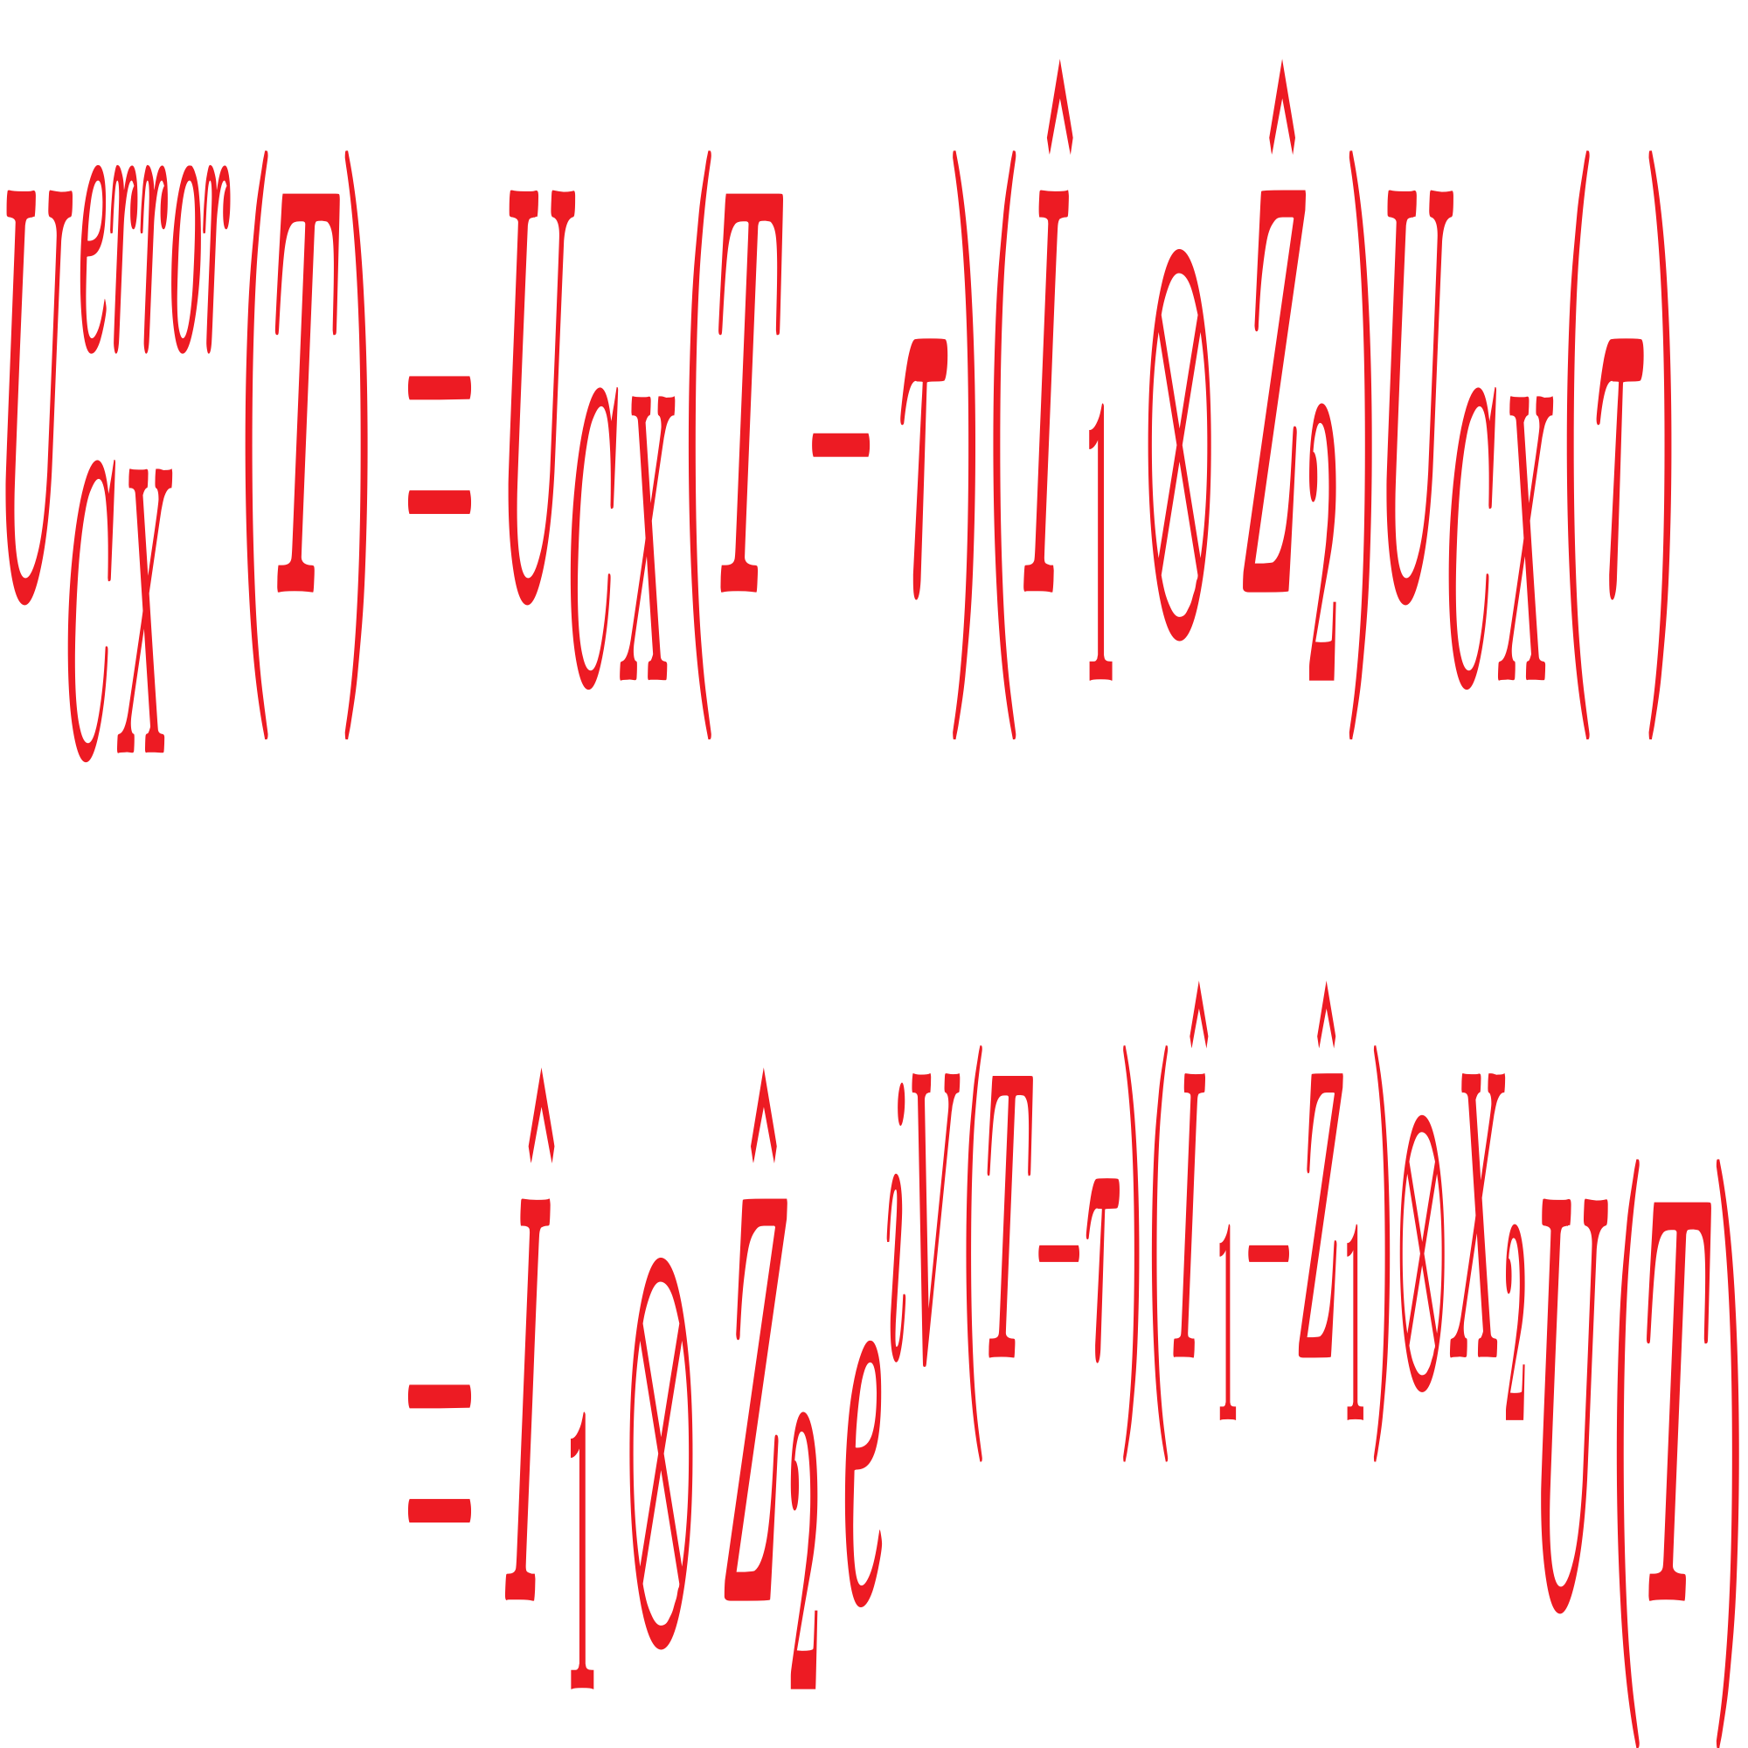


Bias-noise
Unitary CX:
Using the exponential function of Pauli operators
We can get
$$if V = 1,$$
$$π/2 pulse$$
Noisy CX gate (phase-flip error occurs in qubit 2 at time τ)
$$(0<τ<T)$$

Slide 10
Bias-noise
Noise analysis
When an phase-flip error occurs in target qubit, an phase-flip error also occurs in control qubit.
When the unitray operation is complete, target qubit will have both phase-flip error and bit-flip error.
The uncertainty of gate operation (fluctudation) can also cause bit-flip error.
After the gate operation, the noise does not remain in channel Z.
Conclusion
In the strict 2-level system, bias-preserving CX gate is impossible.

Slide 11
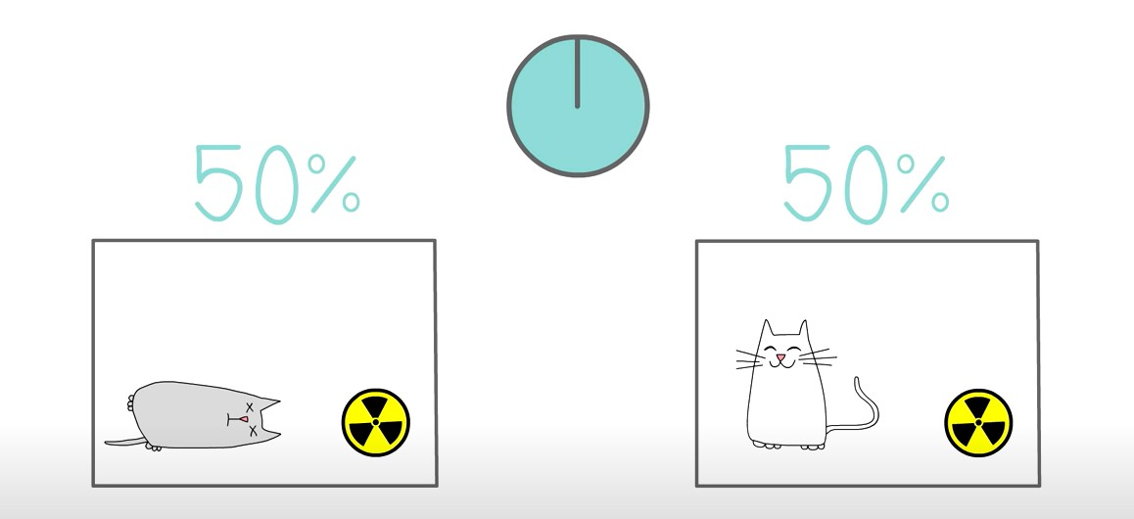
Cat qubit
How can we address these challenges ?
In order to take advantage of biased noise, we need something that acting all universal gate sets in this biased channel.
A better choice is
Cat qubit

Slide 12
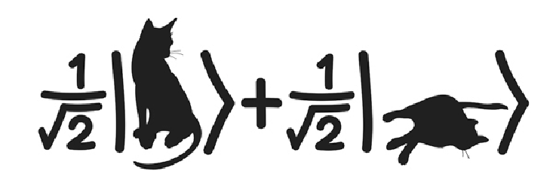
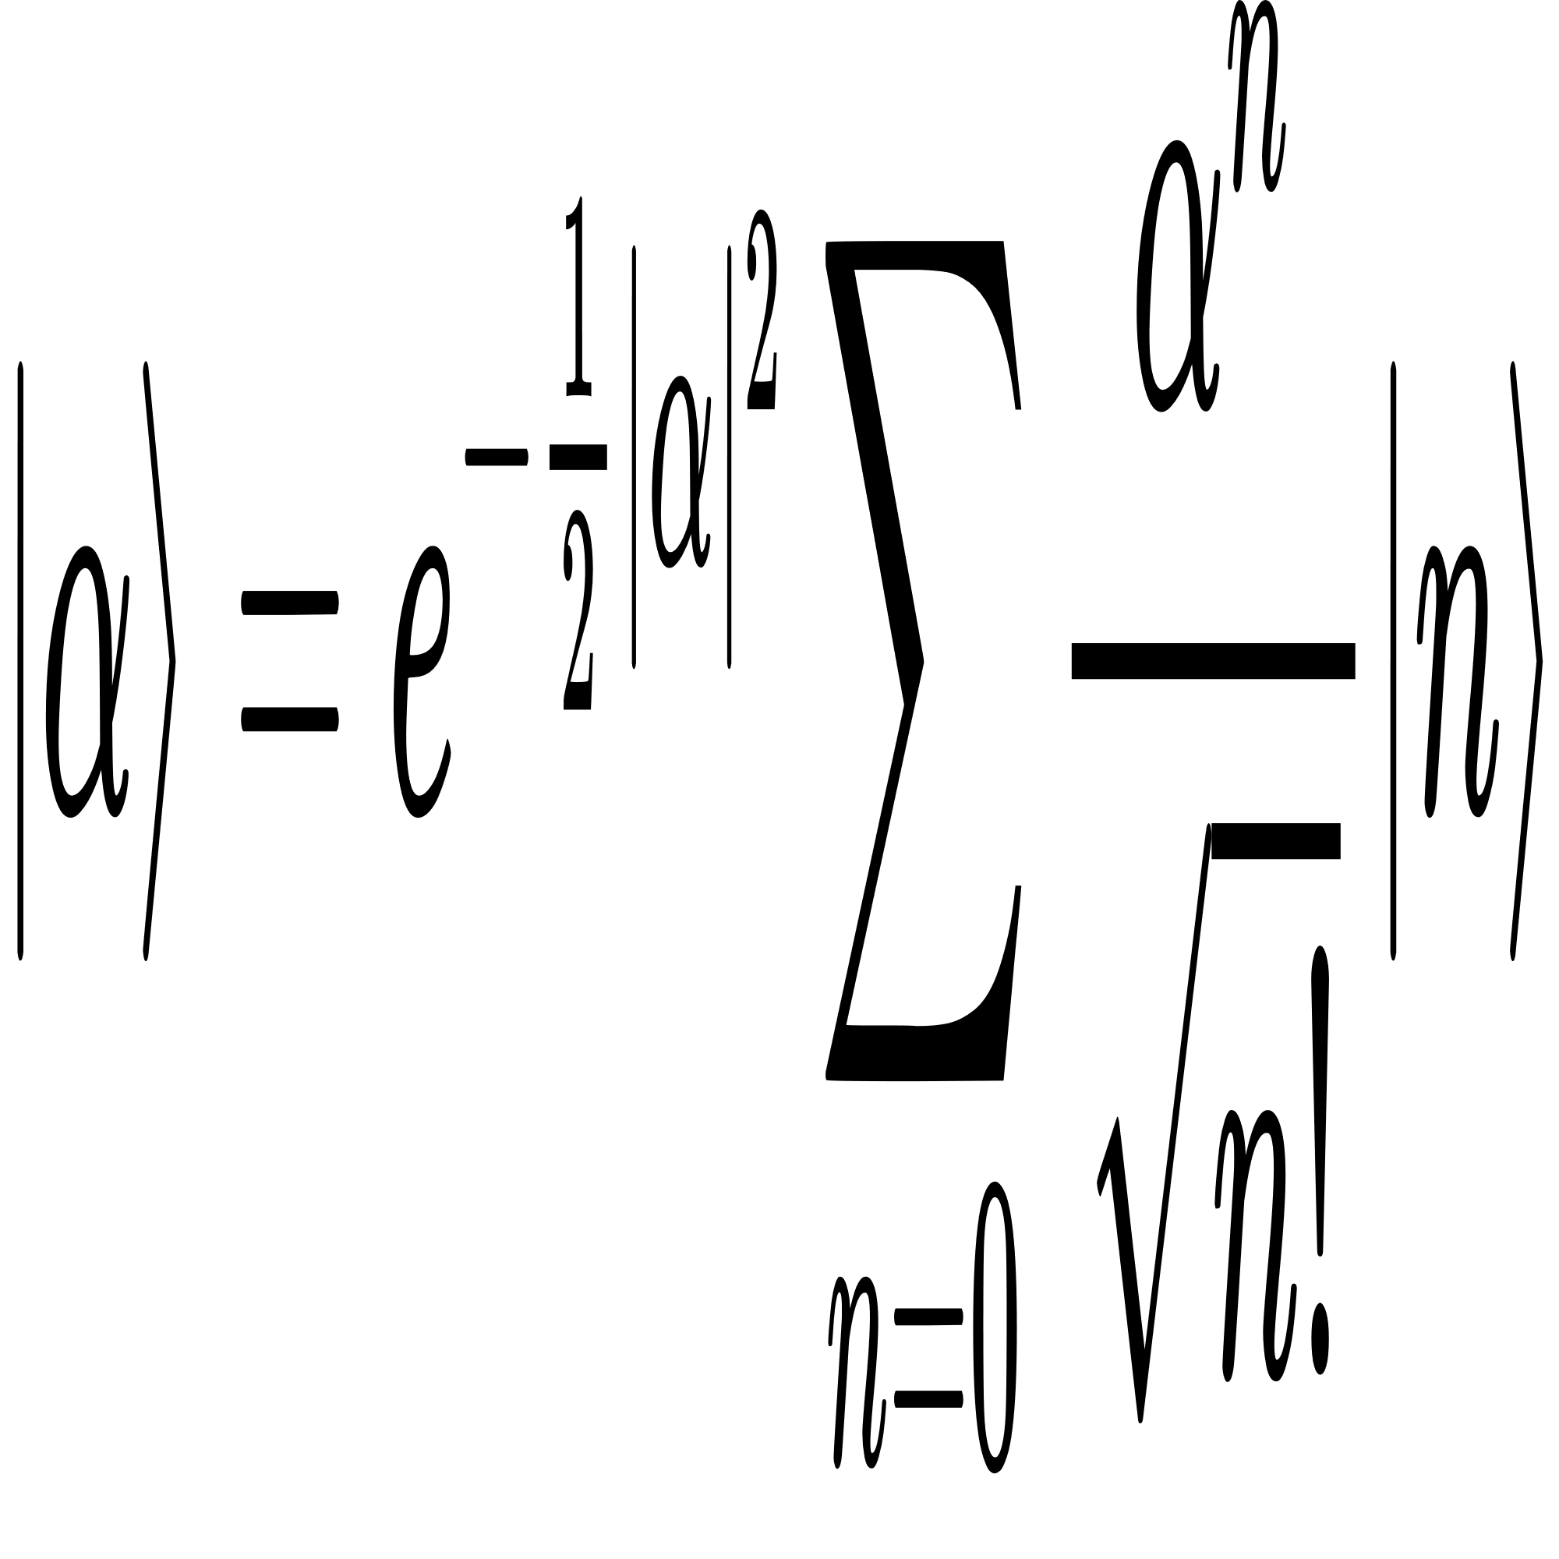
Cat state
What is cat state ?
Cat state, generally, is a quantum state that is a superposition of two completely opposite states.
e.g.
Cats are both alive and dead at the same time
Cat state in quantum optics
Cat state is a superposition of two opposite-phase coherent states of a single mode

Slide 13
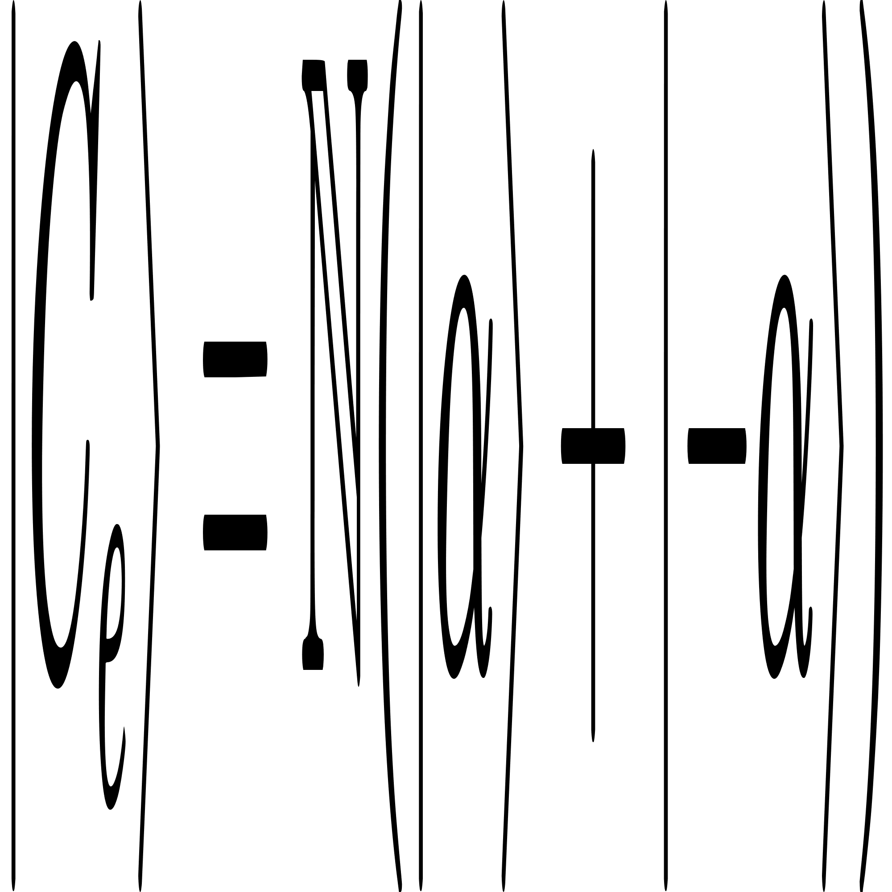
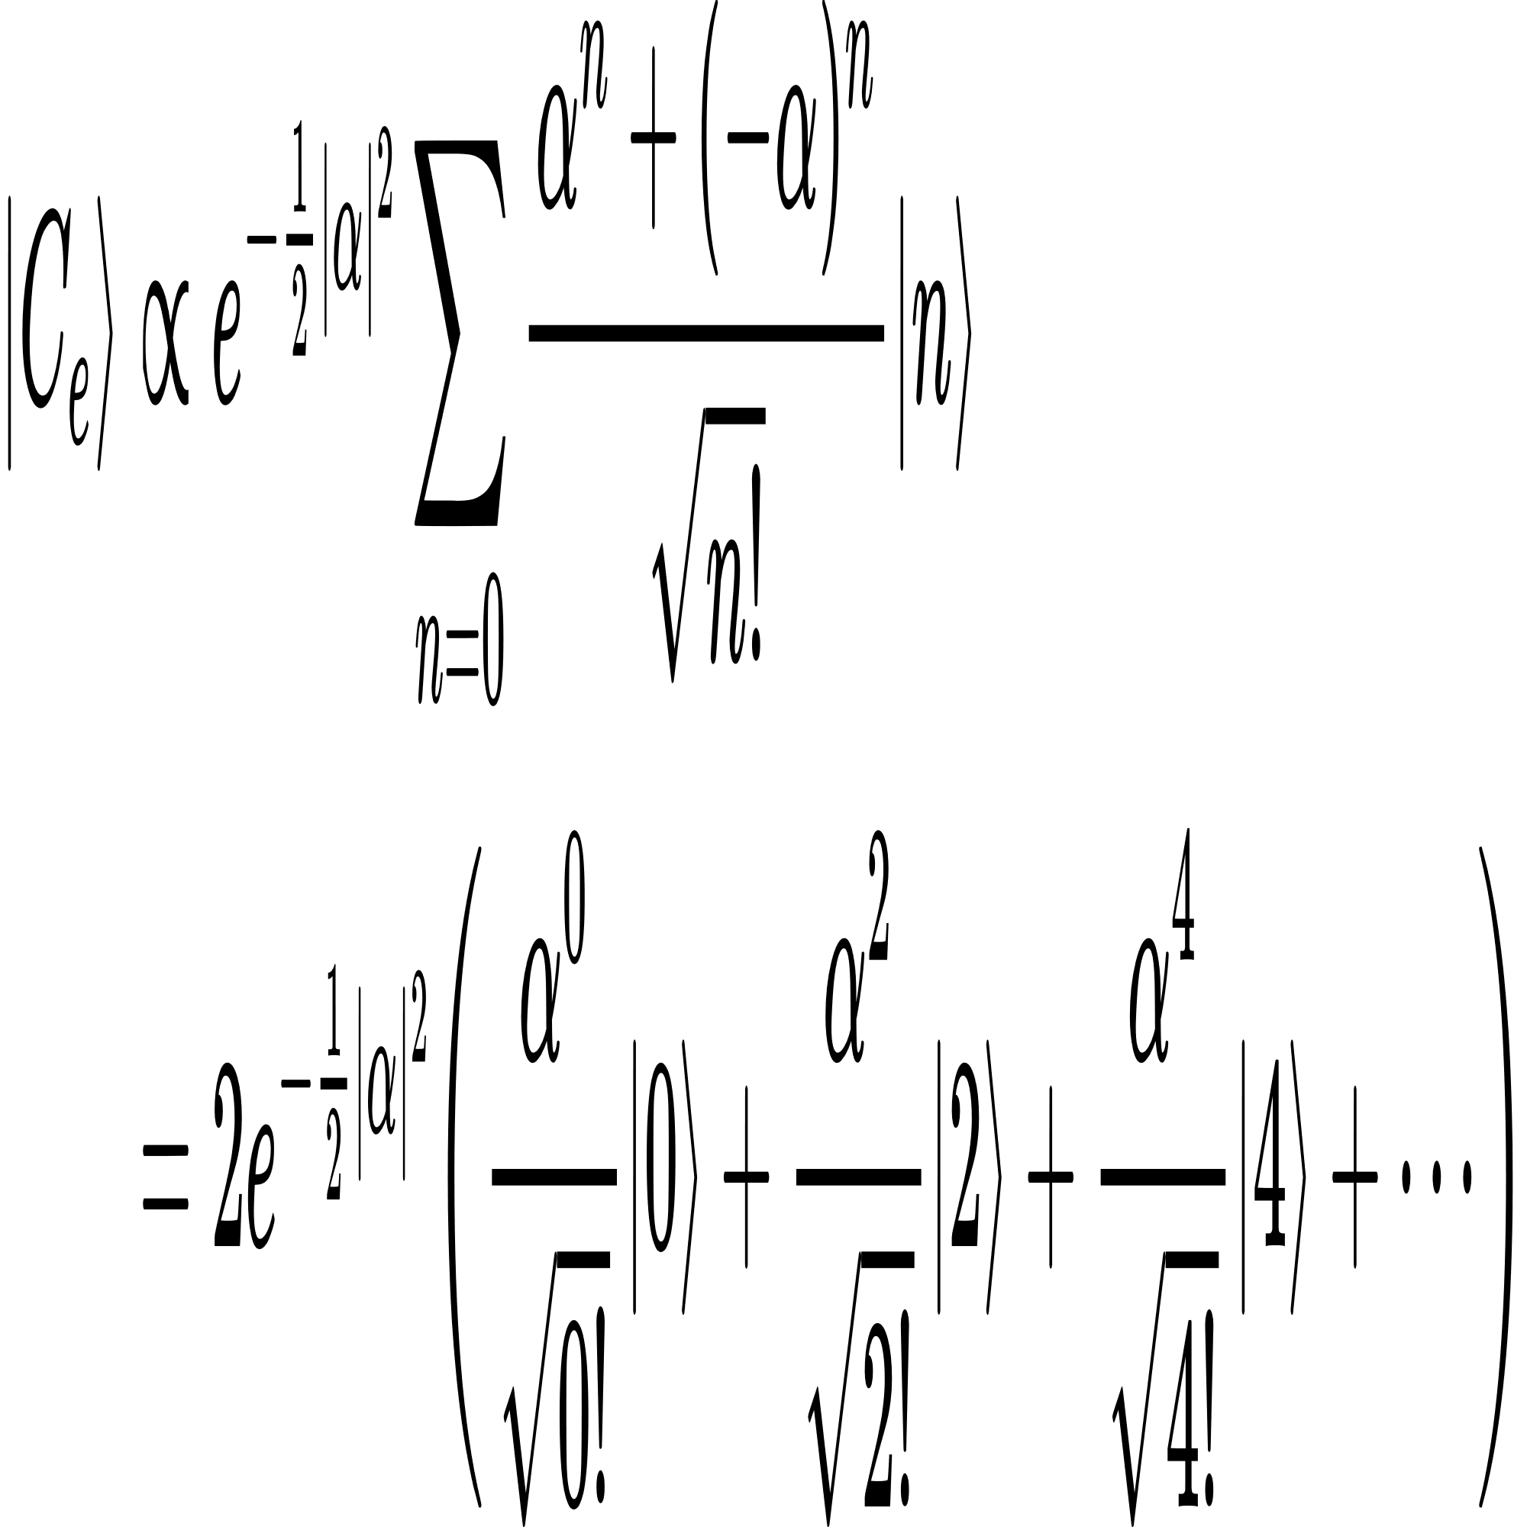
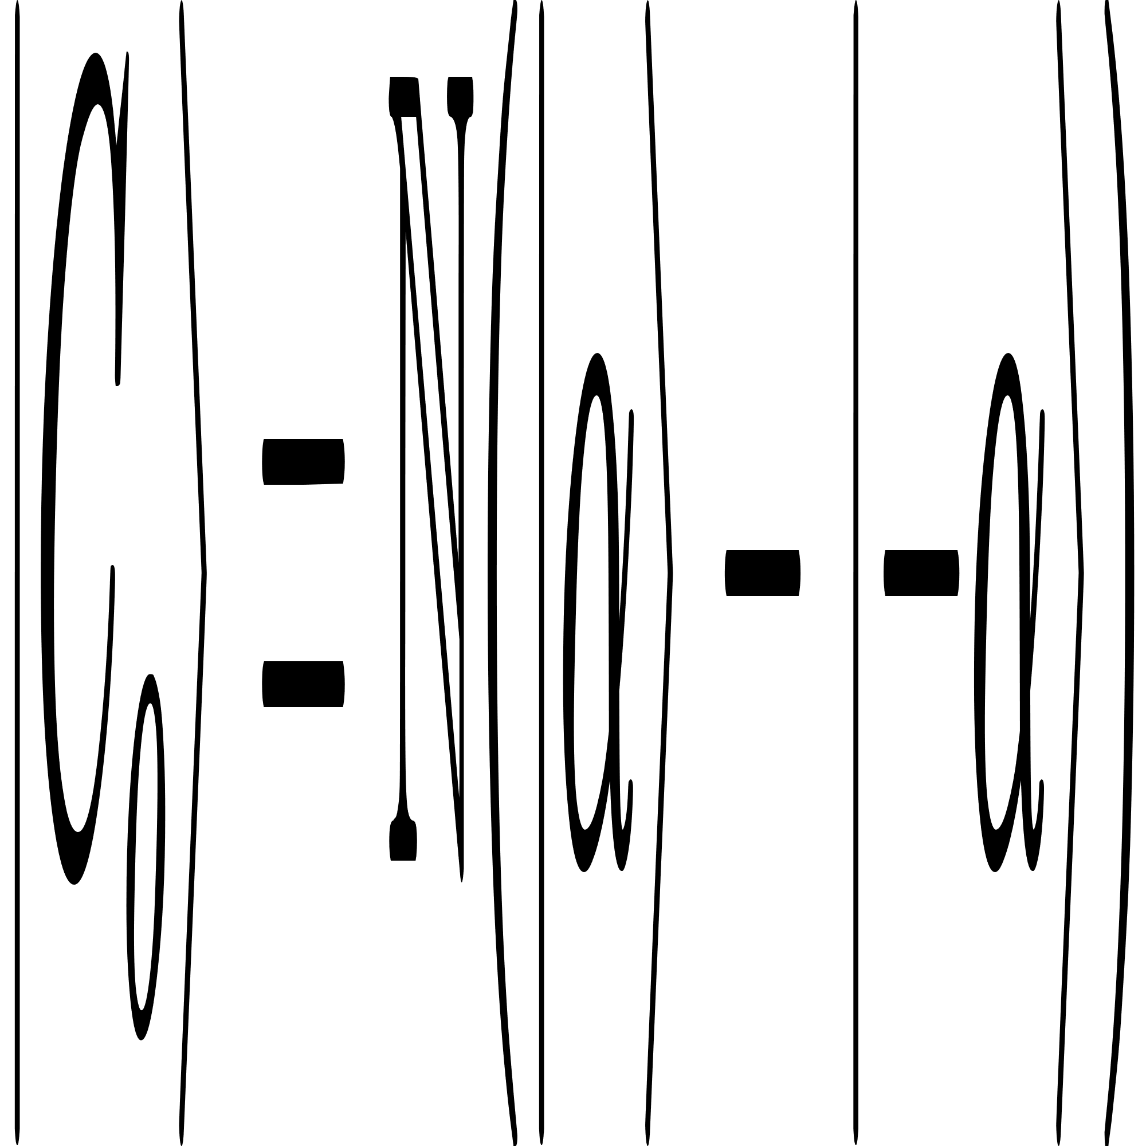
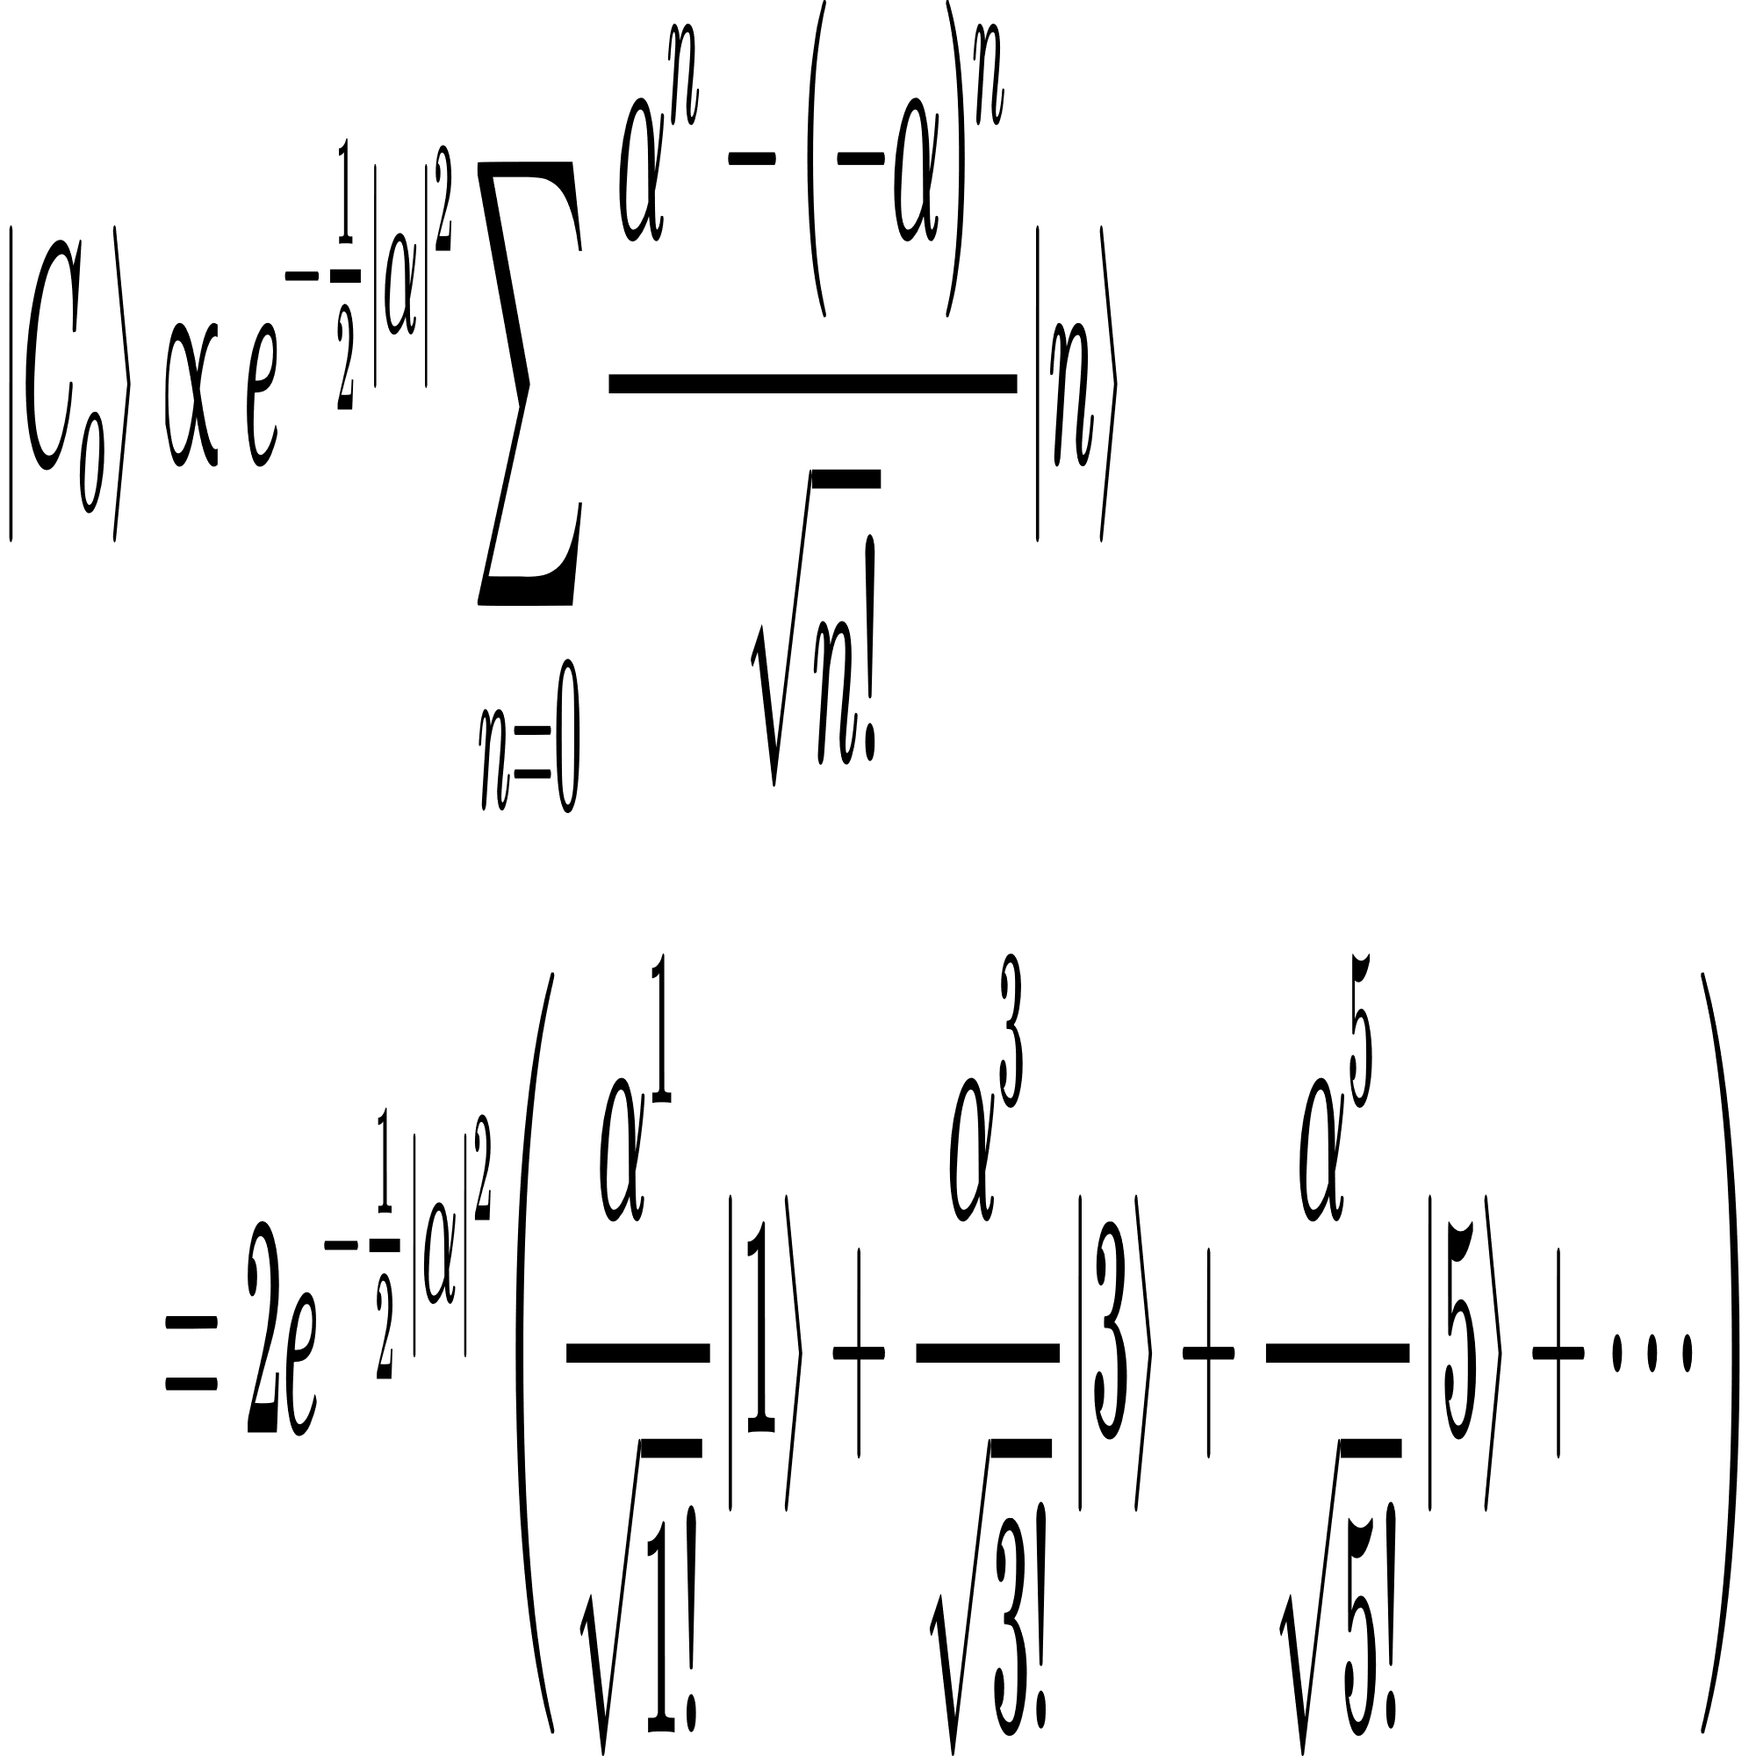
Cat state
Even cat state
Define
Why even ?
Cat state
Odd cat state
Define
Why odd ?

Slide 14
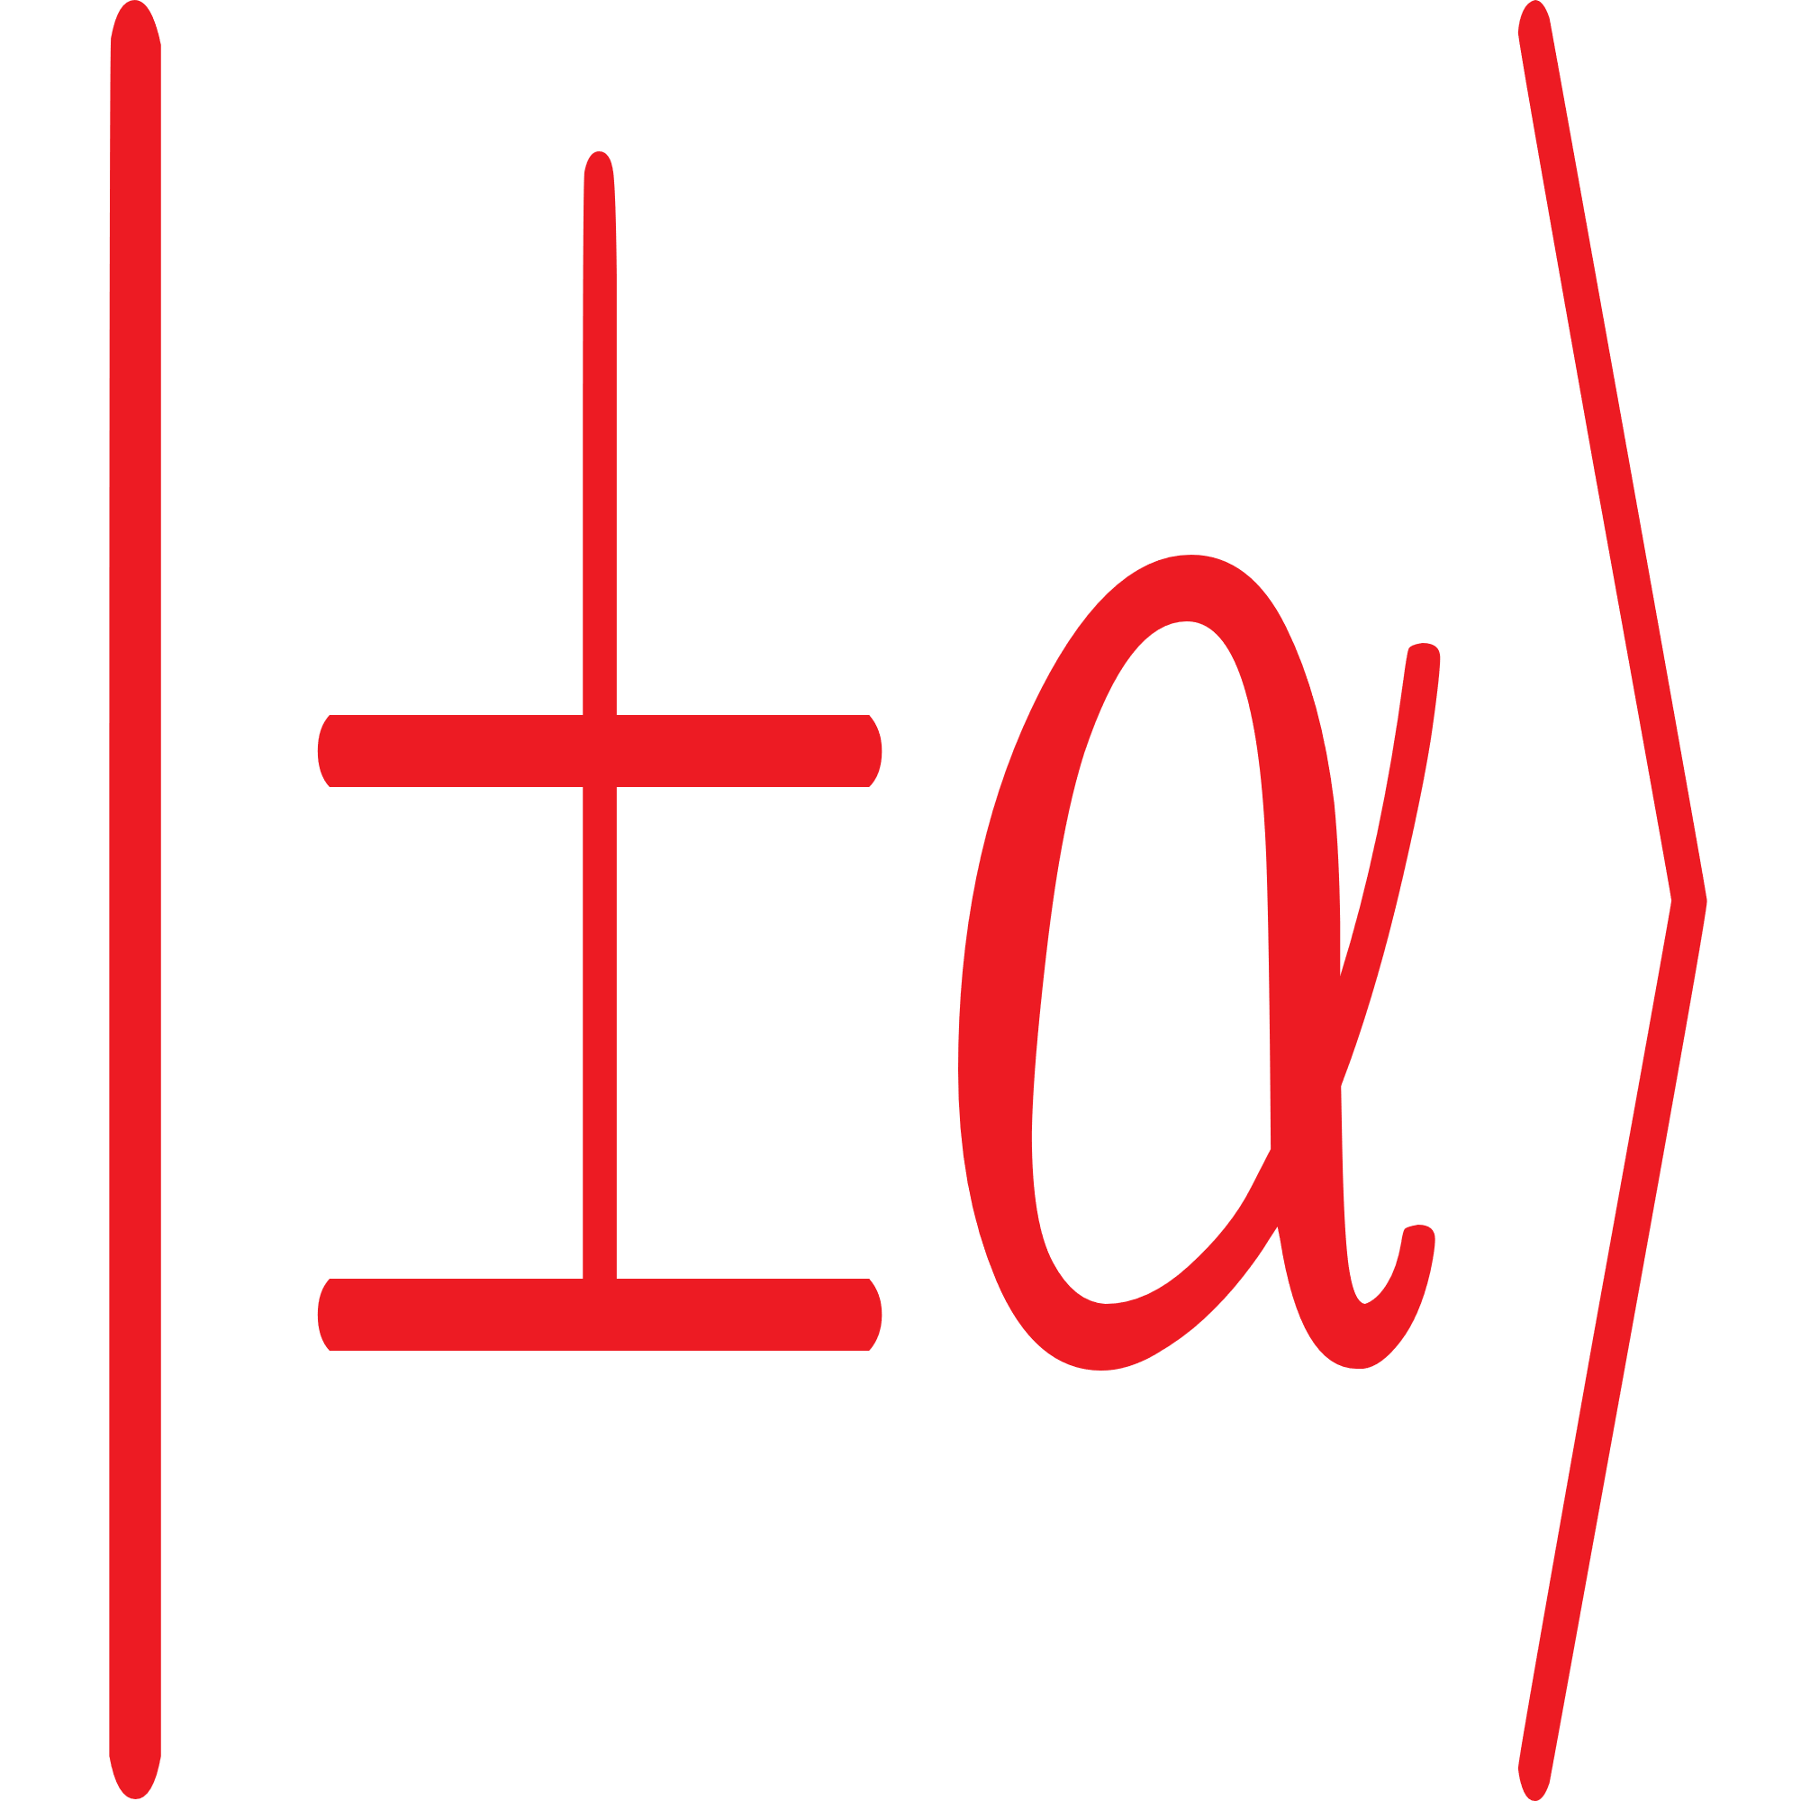
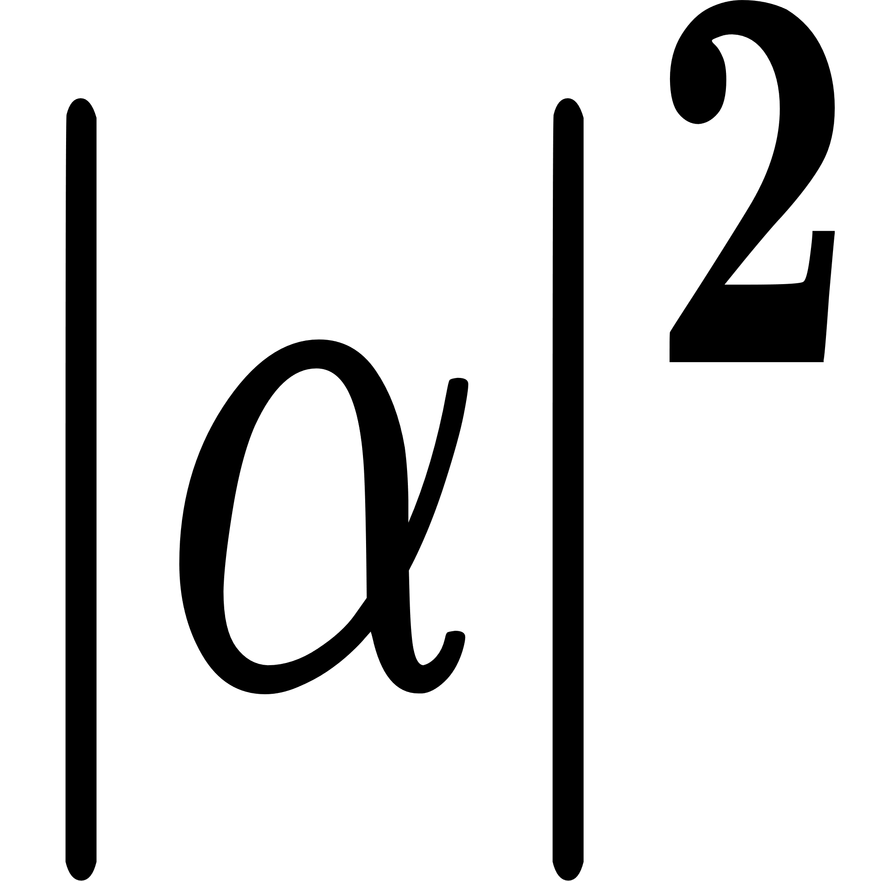
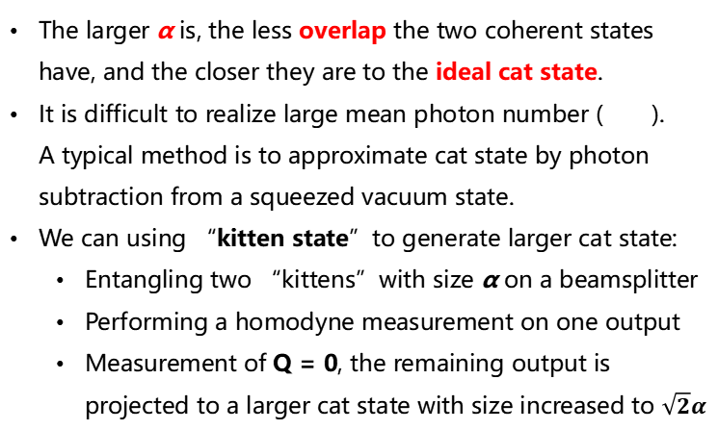
Cat state
Features
The larger α is, the less overlap the two coherent states have, and the closer they are to the ideal cat state.
It is difficult to realize large mean photon number ( ). A typical method is to approximate cat state by photon subtraction from a squeezed vacuum state.
We can using “kitten state”to generate larger cat state:
Entangling two “kittens”with size α on a beamsplitter
Performing a homodyne measurement on one output
Measurement of Q = 0, the remaining output is projected to a larger cat state with size increased to $\sqrt{2}α$

Slide 15
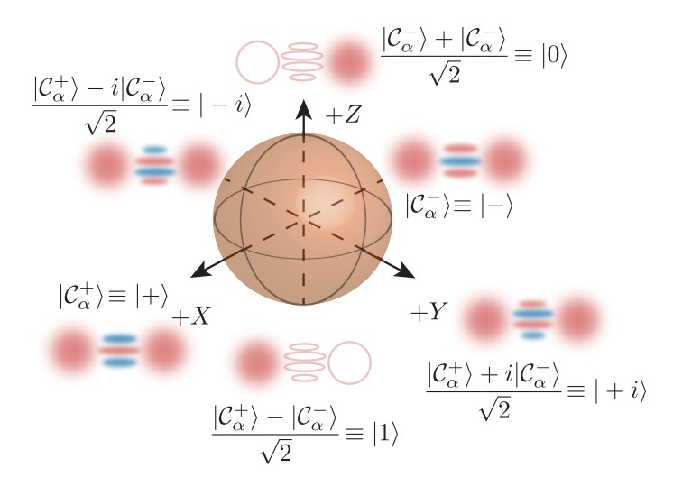
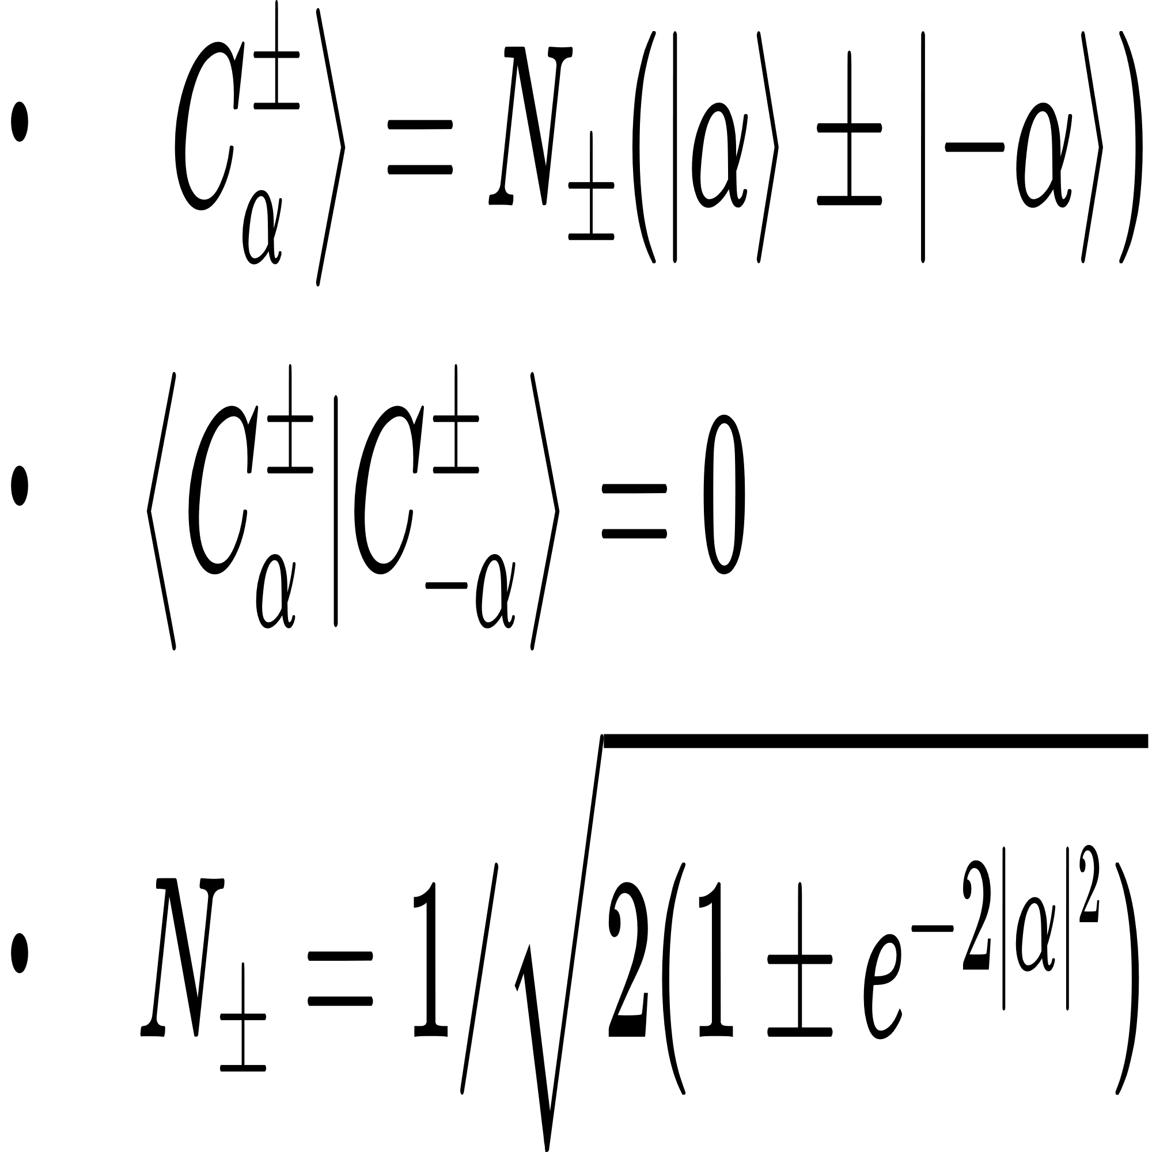
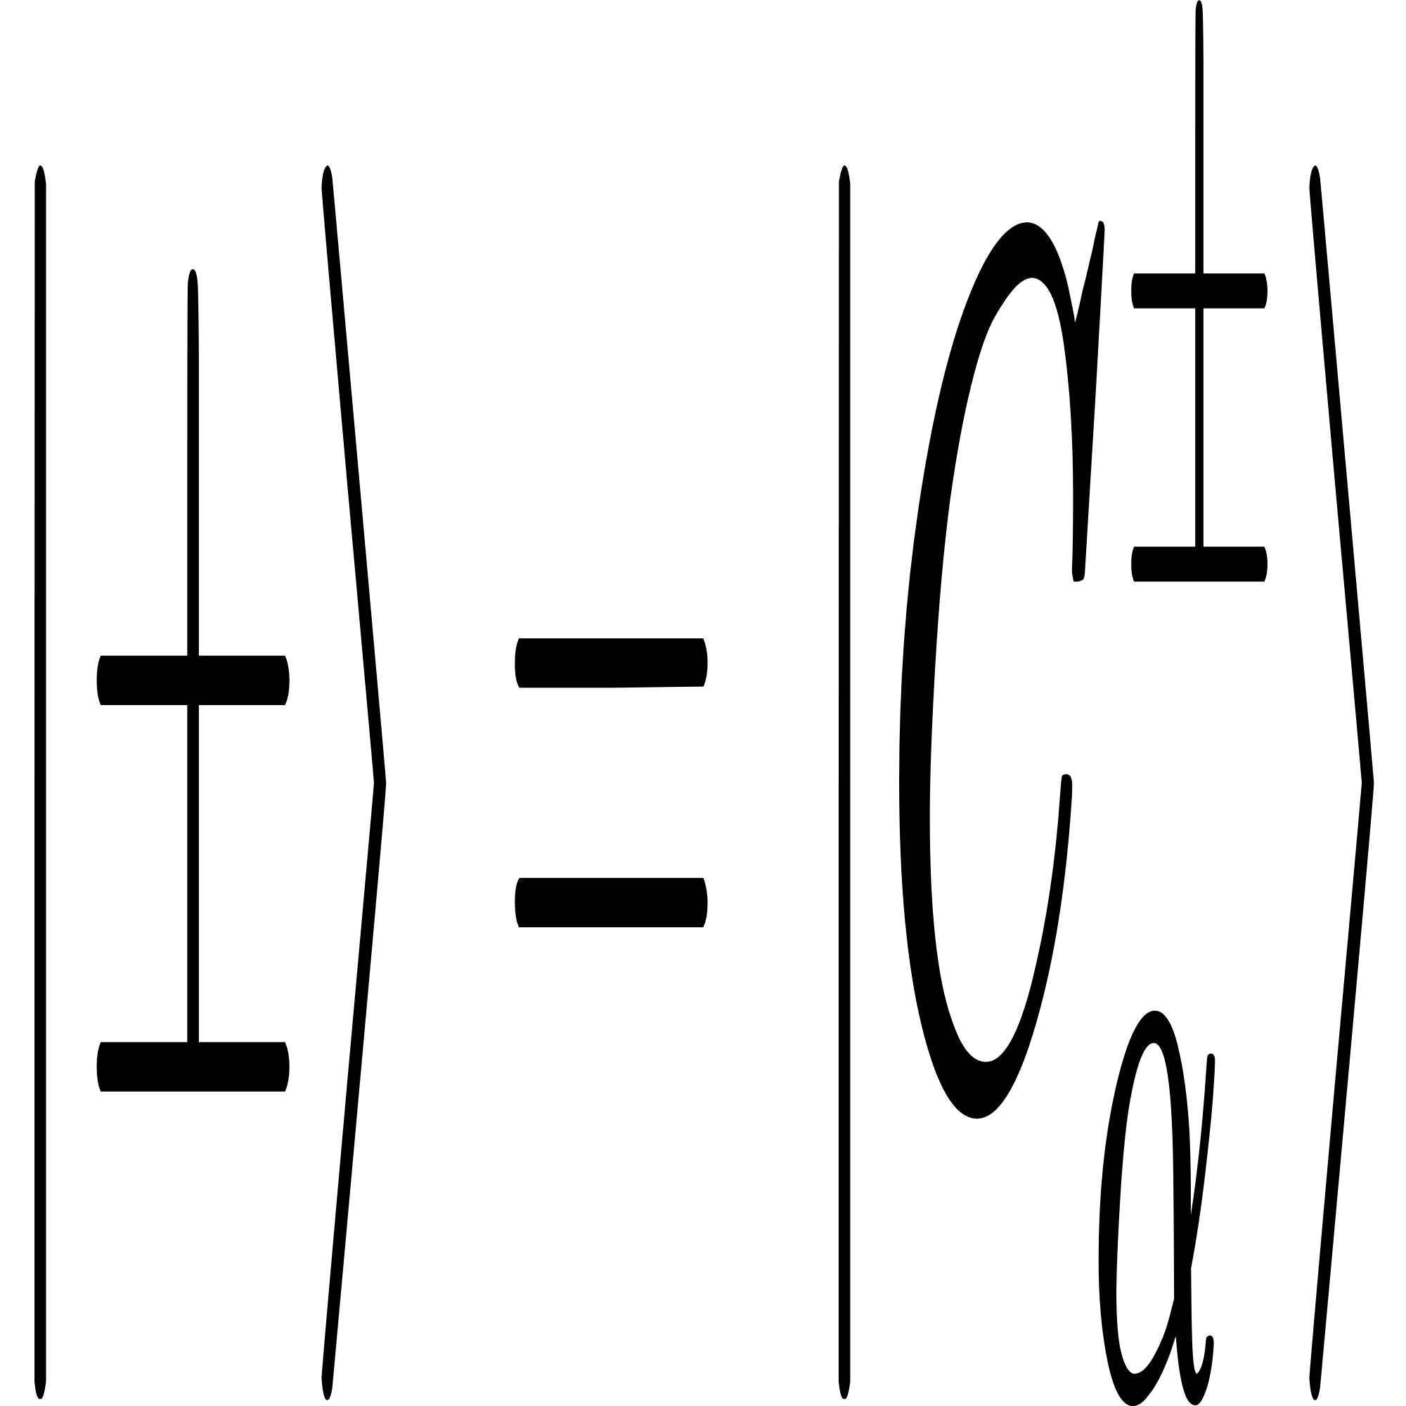
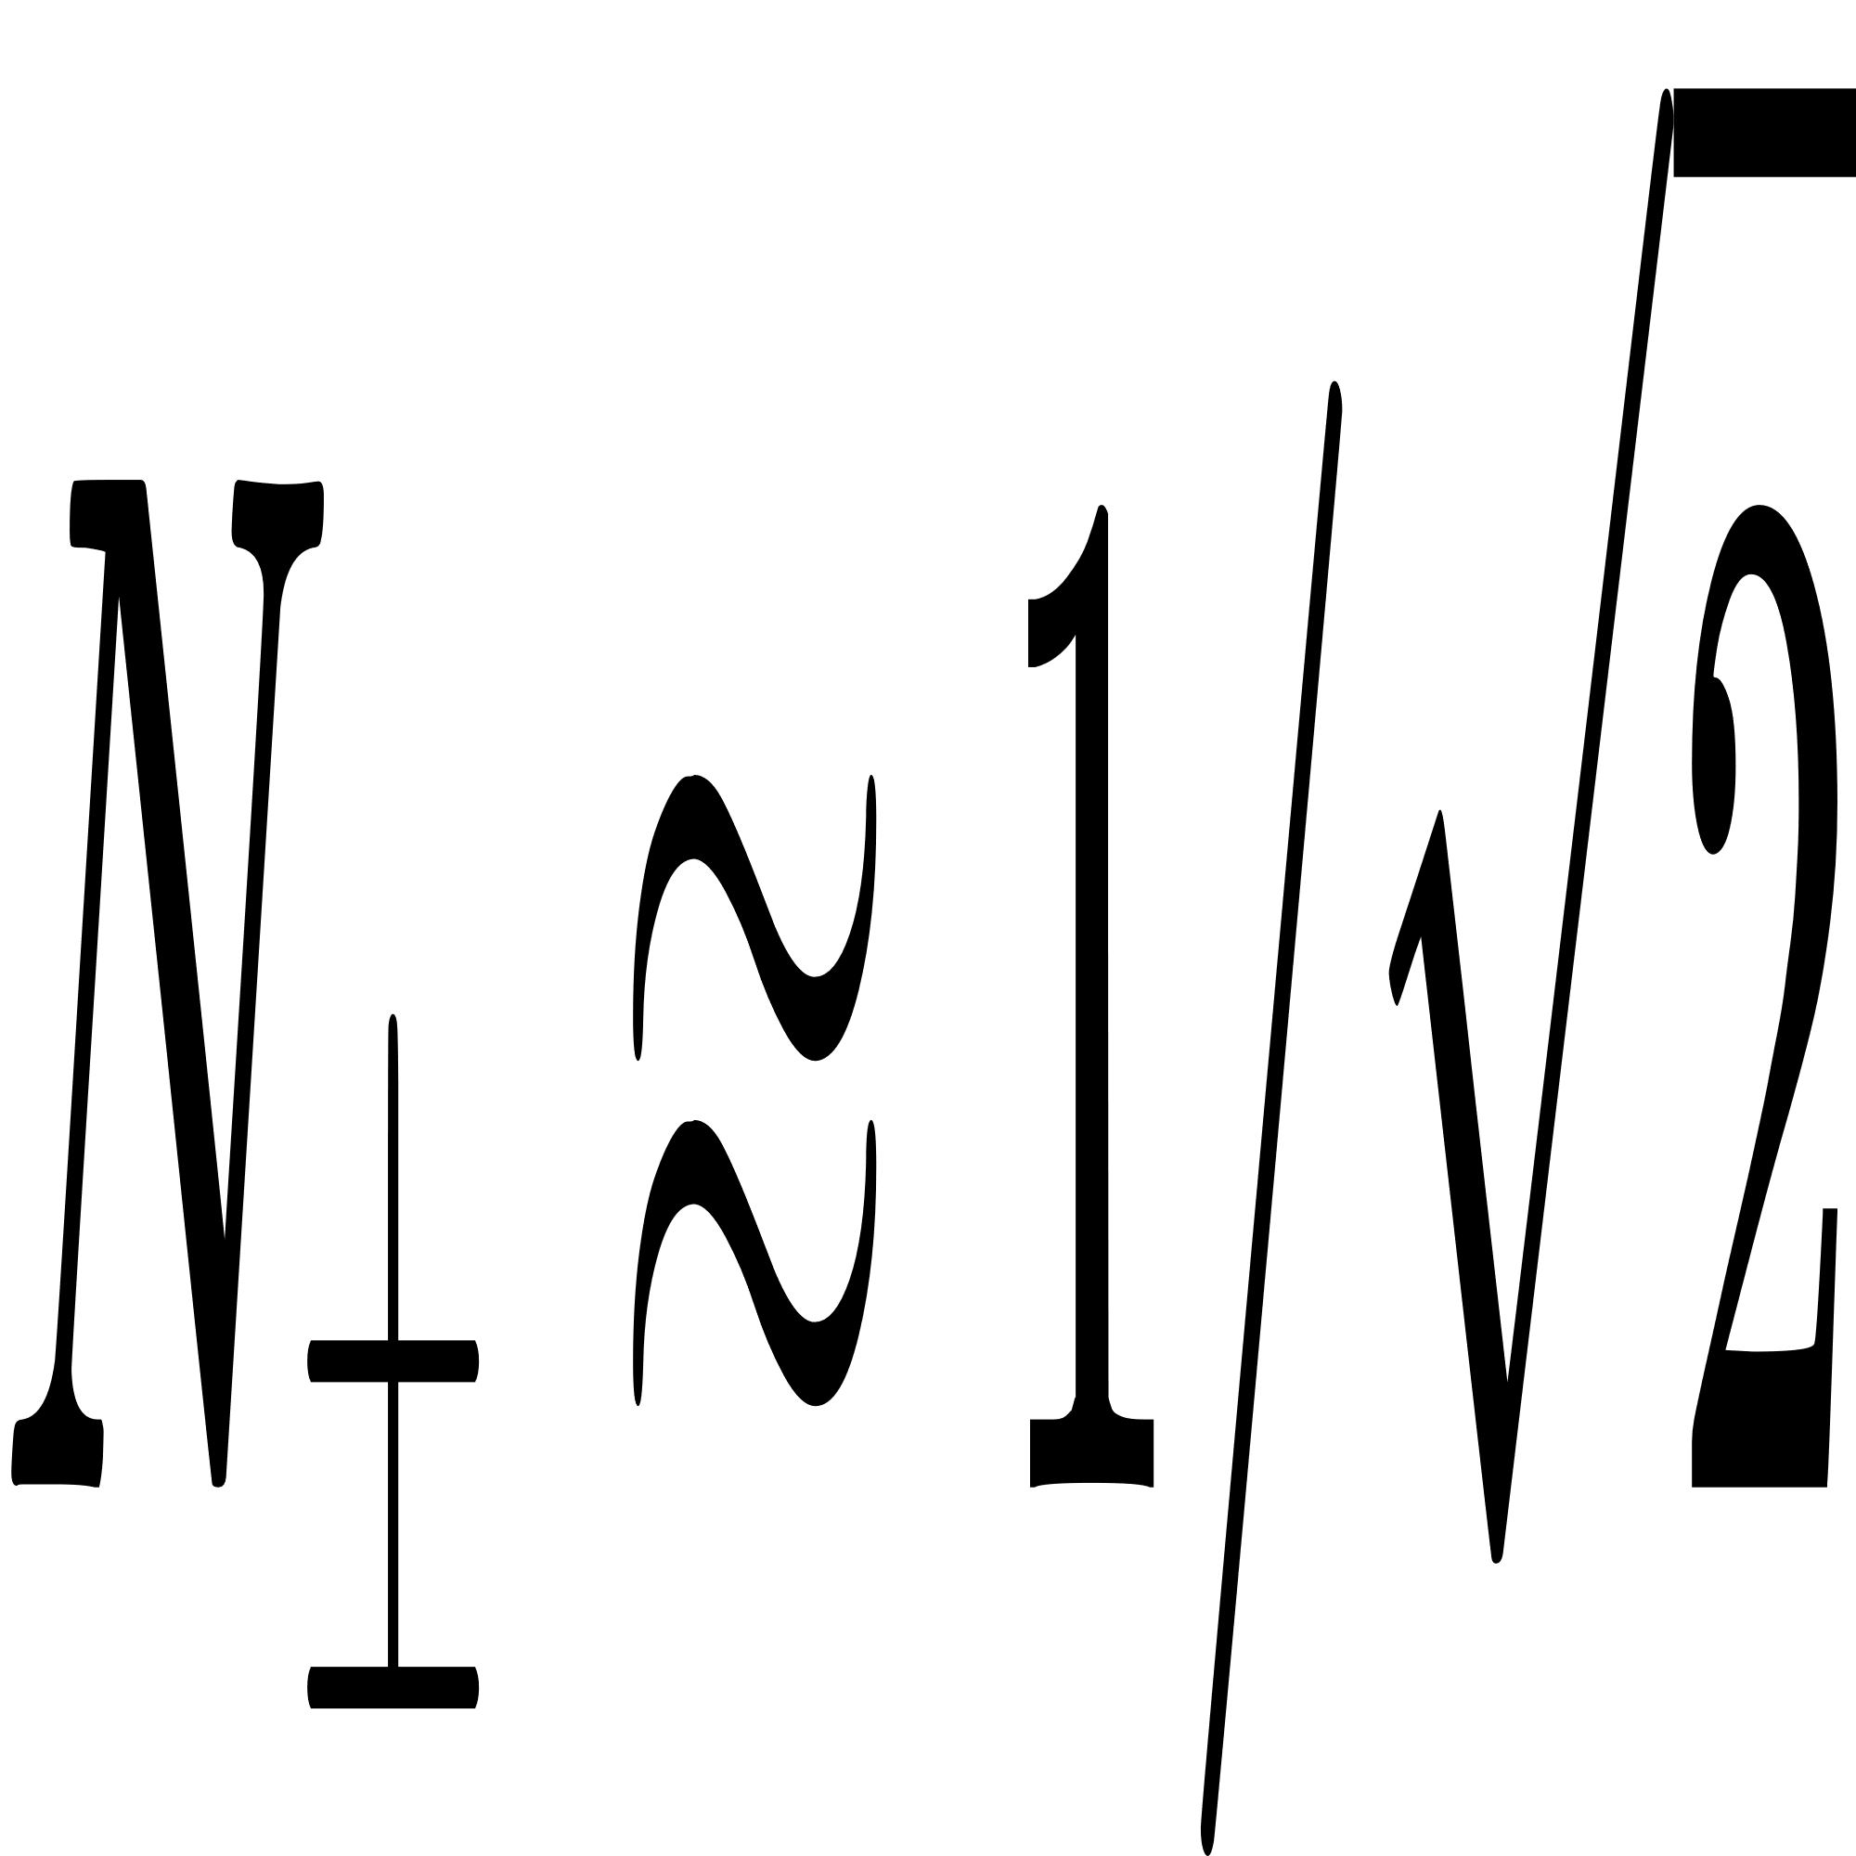
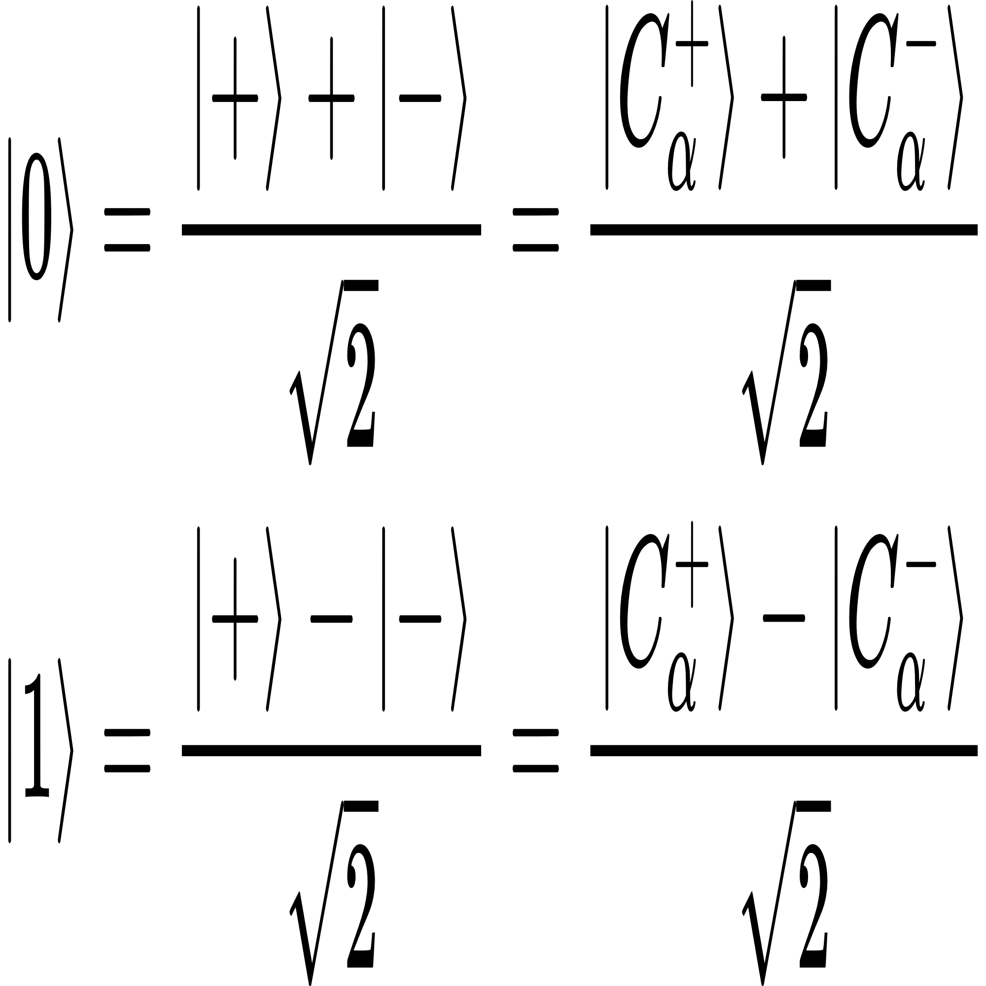
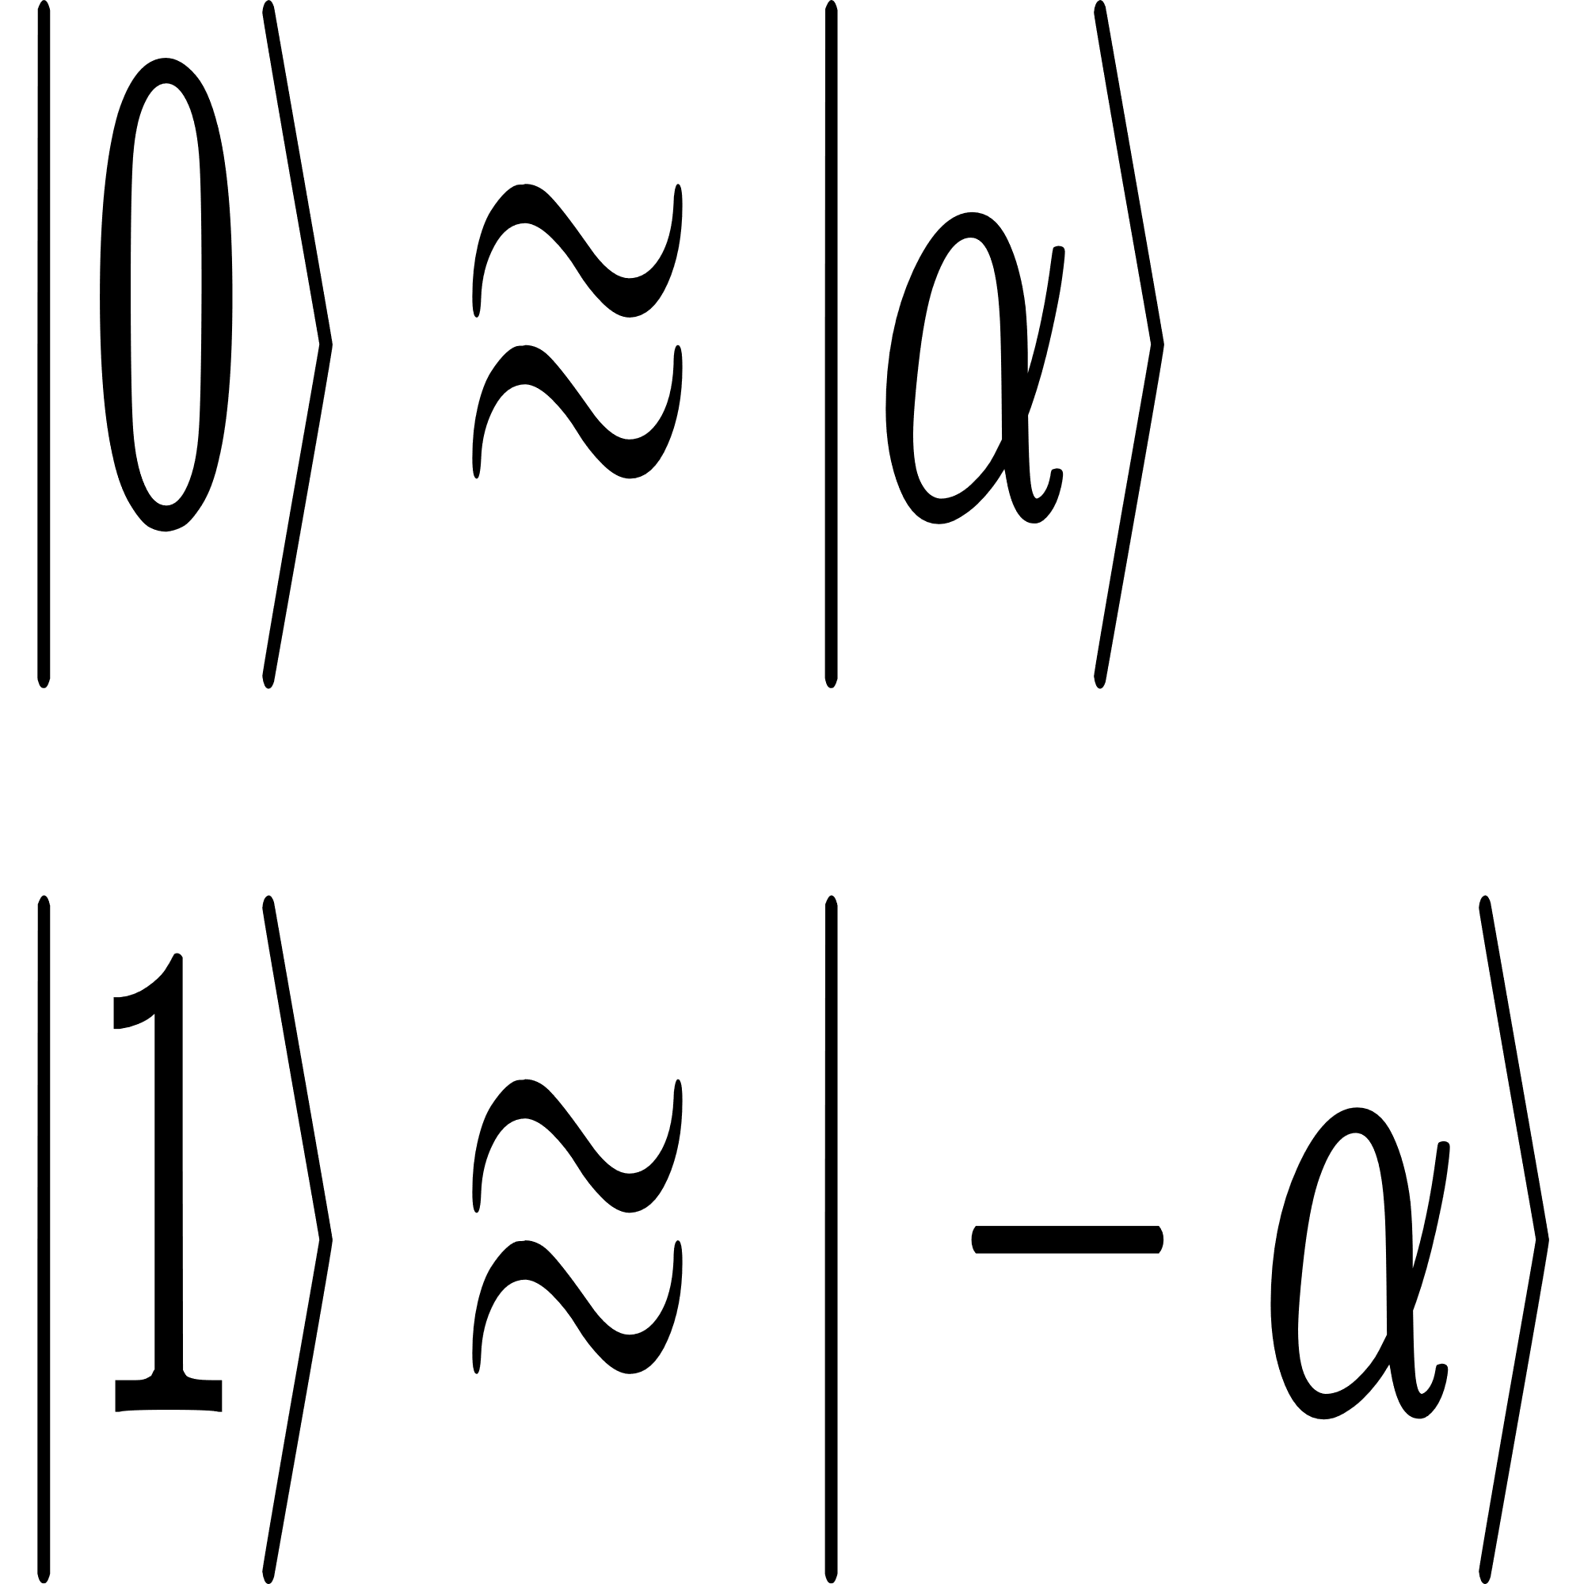
Cat qubit
Physical qubit:
2-component cat state
Fig. 2. Bloch sphere of the cat qubit
Logical qubit configuration
X-axis:
For large α ,
Z-axis:

Slide 16
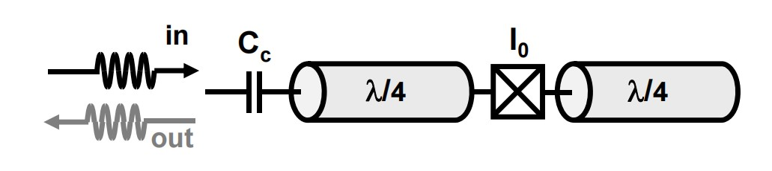
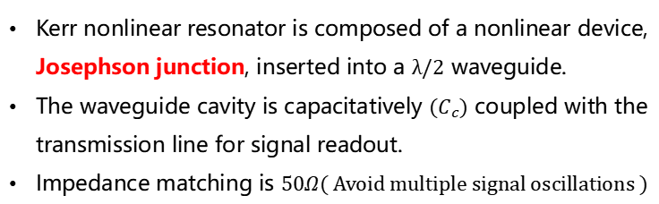
Cat qubit
Physical realization: Two-photon driven nonlinear oscillator
Kerr nonlinear Resonator
Fig. 3. Scheme of the nonlinear resonator
Kerr nonlinear resonator is composed of a nonlinear device, Josephson junction, inserted into a $λ/2$ waveguide.
The waveguide cavity is capacitatively $(C_{c})$ coupled with the transmission line for signal readout.
Impedance matching is $50Ω$( Avoid multiple signal oscillations )

Slide 17
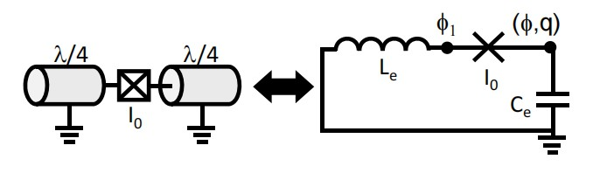
Cat qubit
Equivalent circuit model
Fig. 4. Equivalent circuit of the nonlinear resonator
Hamlitonian

Slide 18
Thank you!
Reporter: Ke-hui Yu
Mentors: Hong-rong Li, Xin Wang
Sep. 2021

